Slide 1
CLSS Users & Departmental Schedulers

Slide 2













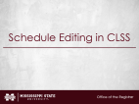



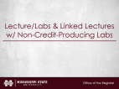




Table of Contents
Right click on the topic you want to jump to and select “Go To Section”

Slide 3
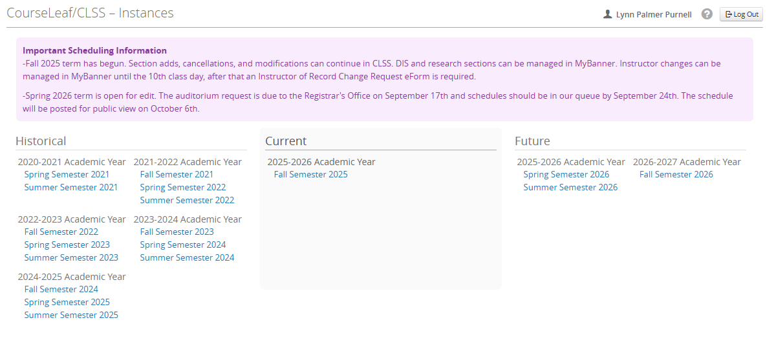
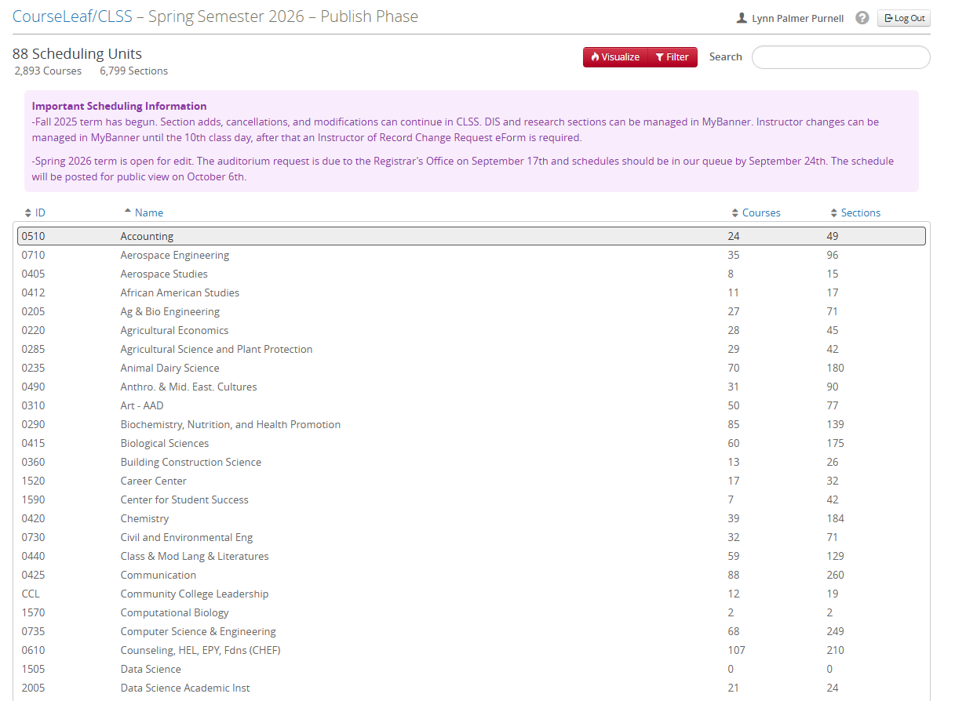
CLSS Terminology vs MSU’s Terminology
Instance = Term
Scheduling Unit = Department

Slide 4
CLSS Modes & Phases

Slide 5

Design Mode
You are building your schedule for the upcoming term. The sections that initially appear are the ones that existed in the corresponding term from the previous academic year. The following sections will not roll forward: Cancelled sections, DIS sections, Thesis/Dissertation sections, Special Topics courses, Inactivated courses, & Courses with changes to their fundamental attributes (credit hours, schedule type, etc.). As you work, you can save each section individually. Once you've finished reviewing, editing, and adding all of your sections, you'll submit the entire schedule for approval at one time. For those who have scheduled courses for years, think of this as the electronic version of the old process: we would send you a packet containing your schedule from the previous like term, you would make your edits and additions, and then return the entire packet to us. CLSS follows that same overall workflow—it just does it electronically.
* You cannot submit a special topic section until you are in Refine Mode!

Slide 6
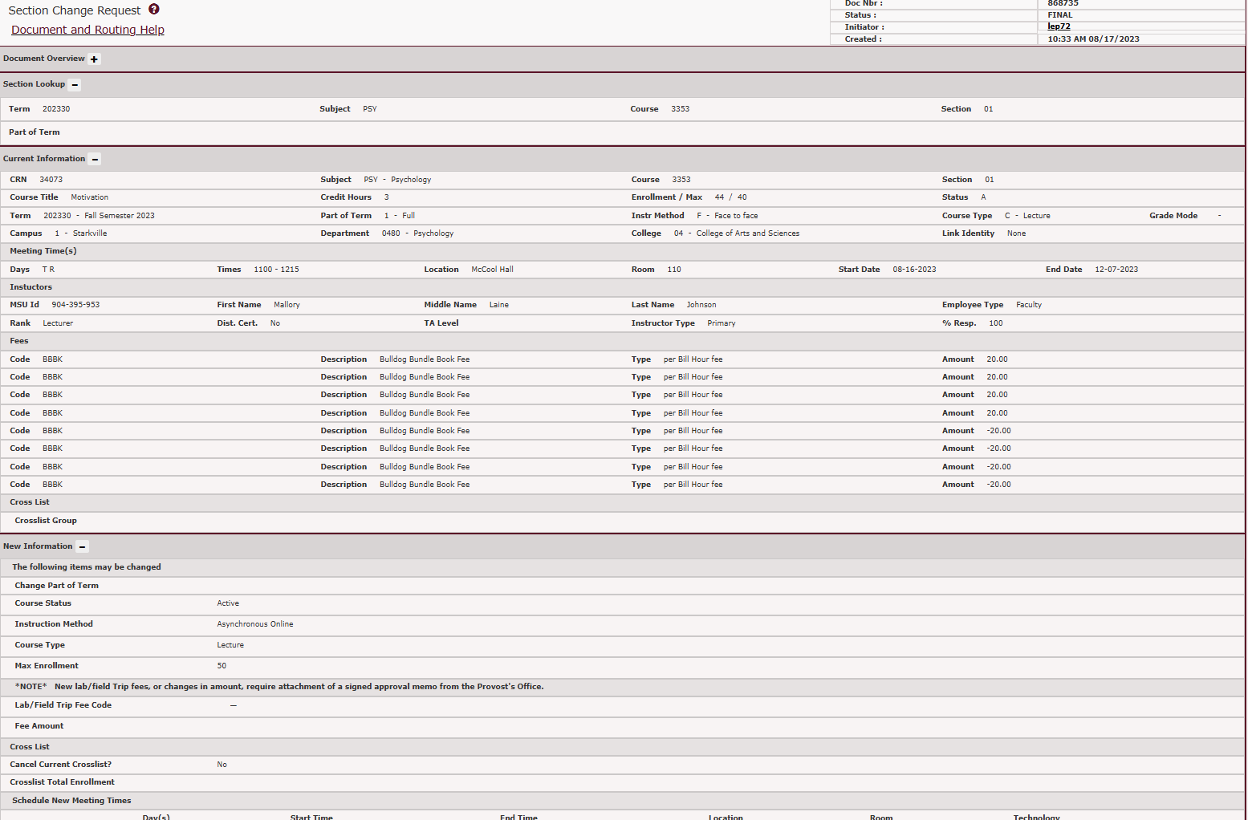
Refine Mode
You’re making tweaks to a section individually. After saving the section, you’ll submit just that section for approval through the workflow. For old school schedulers, this is when you used to do the section add or section change eForm. The move to this mode is automatic. Once we bridge your entire schedule to Banner, CLSS automatically switches you to Refine Mode.

Slide 7
CLSS Phases
Schedule Build
Proof
Publish
Room Assignment
THEN
Registration
Beginning of Term
Active Term
Locked
Archive
Phases are stages in the scheduling and registration cycle that determine what fields in CLSS can be edited. As each phase progresses, some fields become unavailable for editing or require additional steps to modify. The Scheduling Team in the Office of the Registrar manages all phases.

Slide 8
Modes & Phases Flow Chart
Design Mode
Schedule Build Phase
1
Refine Mode
Schedule Build Phase
2
Proof Phase
3
Publish Phase
4
Room Assignment
5
Registration
Phase
6
Archived Phase
10
Locked Phase
9
Active Term Phase
8
Beginning of Term Phase
7

Slide 9
Editable Fields During Each Phase
Admin Only
Nothing is editable until we get all initial room assignments done.

Slide 10
Editable Fields During Each Phase
Schedule Build & Proof

Slide 11
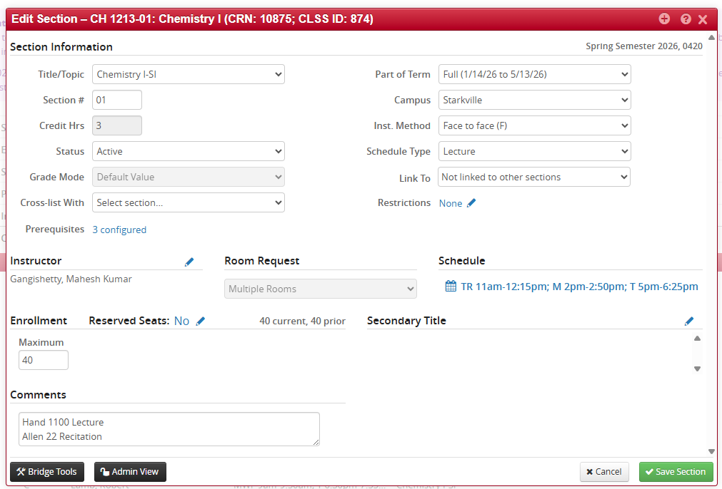
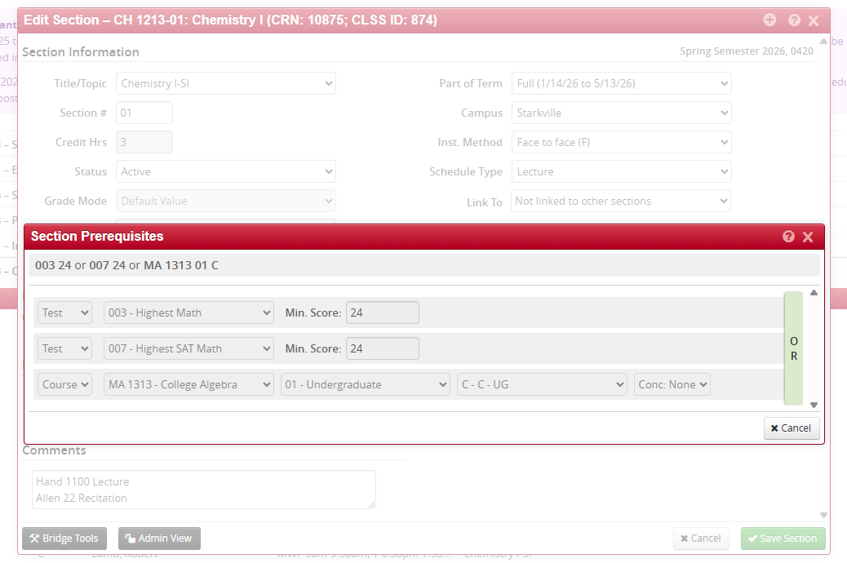
Schedule Build & Proof Phase
The only two things you CANNOT change during the Schedule Build &/or Proof Phase are the Pre-requisites and Grade Mode, but these things are NEVER changeable. The pre-requisites can be view but can only be changed through a modification with UCCC.

Slide 12
Editable Fields During Each Phase
Publish
- Can no longer delete a section, you must cancel it.
- After the 10th class day an Instructor of Record Change Request eForm is needed.

Slide 13
Editable Fields During Each Phase
Room Assignment
Like in Admin Phase, nothing is editable until we get all initial room assignments done.

Slide 14
Editable Fields During Each Phase
Registration
- Can no longer delete a section, you must cancel it.
After the 10th class day an Instructor of Record Change Request eForm is needed.
Room Seek will be open to find available rooms for a section and request.

Slide 15
Editable Fields During Each Phase
Beginning of Term
- Can no longer delete a section, you must cancel it.
After the 10th class day an Instructor of Record Change Request eForm is needed.
Room Seek will be unavailable to keep everyone from stepping on each others toes when requesting rooms.

Slide 16
Editable Fields During Each Phase
Active
- Can no longer delete a section, you must cancel it.
After the 10th class day an Instructor of Record Change Request eForm is needed.
Room Seek will re-open.

Slide 17
Editable Fields During Each Phase
Locked & Archived
No changes can be made; you can only view the past schedule.

Slide 18
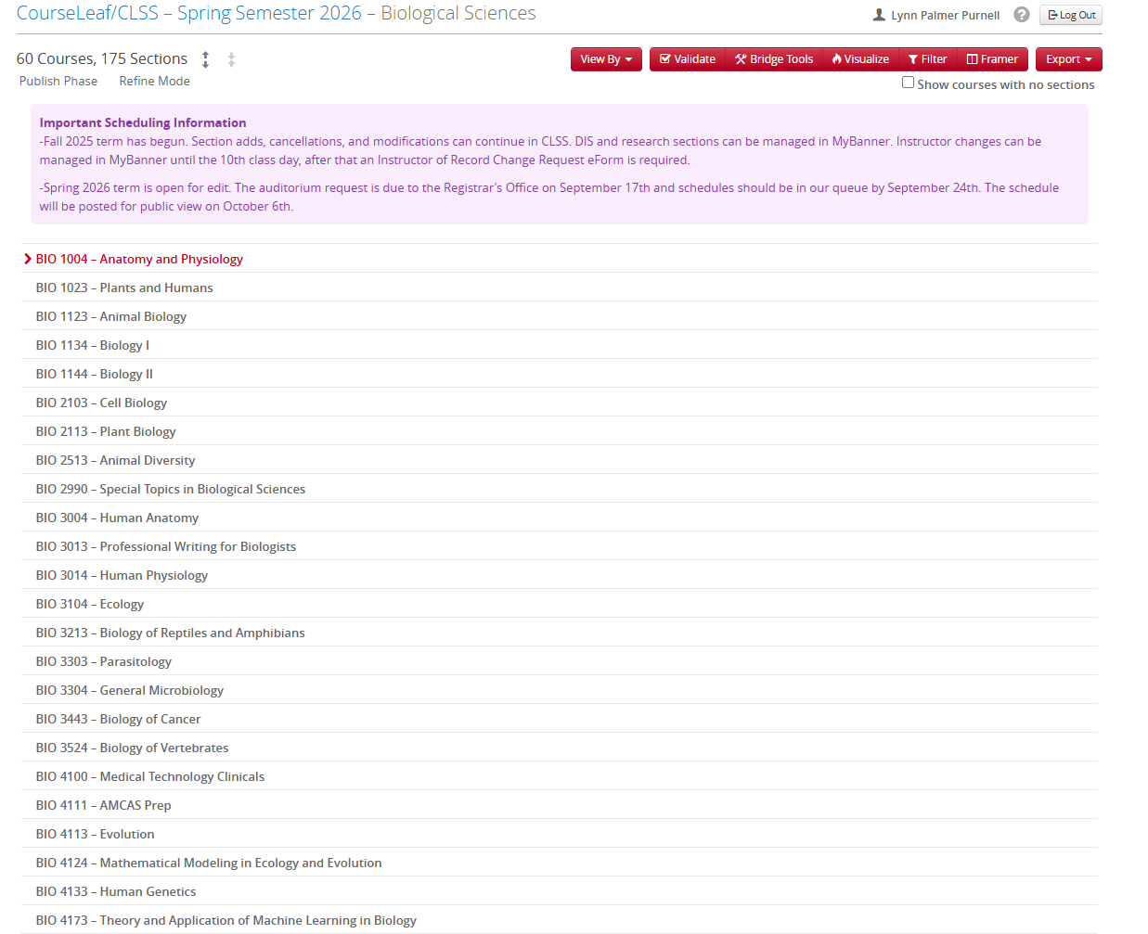
Where to See the Current Mode & Phase

Slide 19
Where to See the Current Mode & Phase

Slide 20
Accessing the Schedule

Slide 21
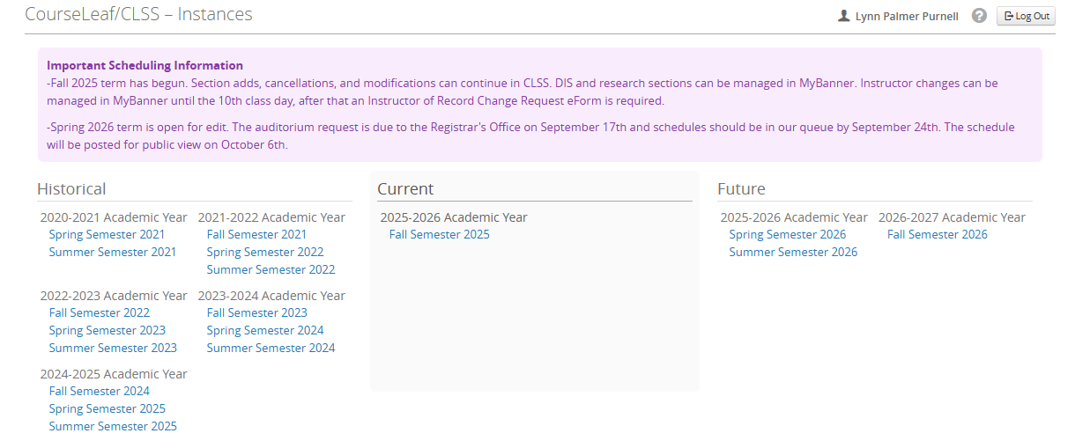
Accessing a Term
Step 1: Go to https://next.catalog.msstate.edu/wen/ to get to the Instances screen & double click on the term you need to access.

Slide 22
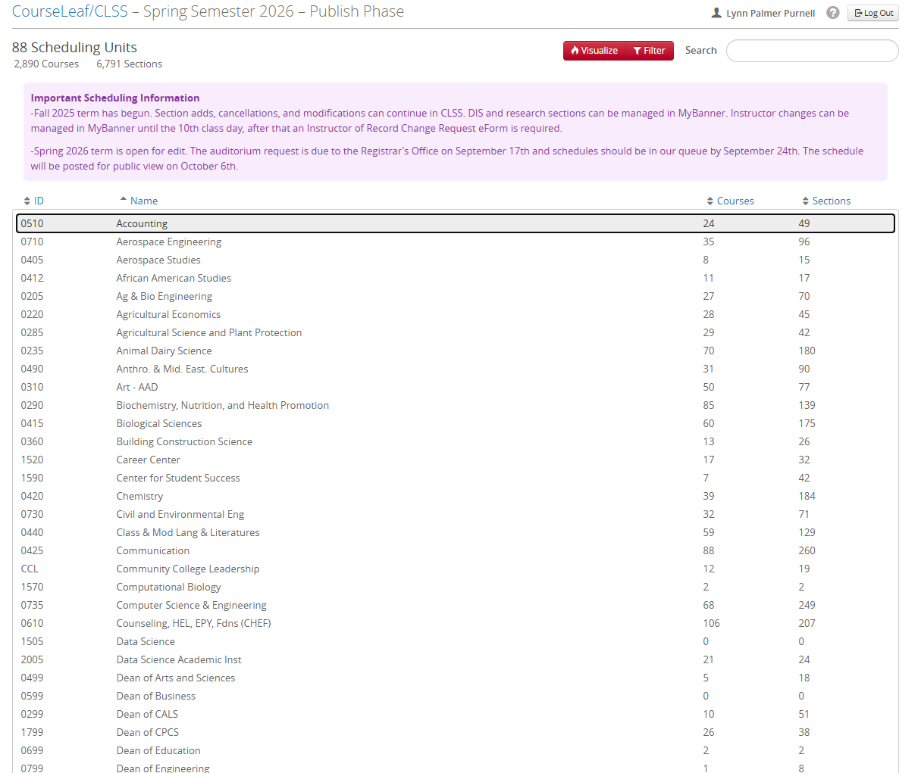
Accessing the Schedule
Step 2: Find your Scheduling Unit / Department & double click (they are in alphabetical order).

Slide 23
Schedule Editing in CLSS

Slide 24
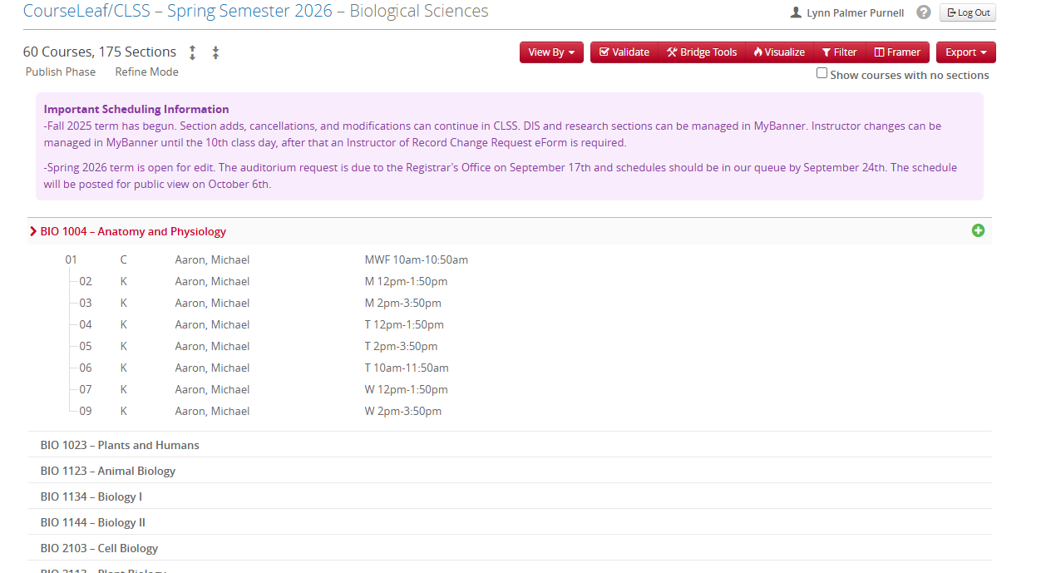
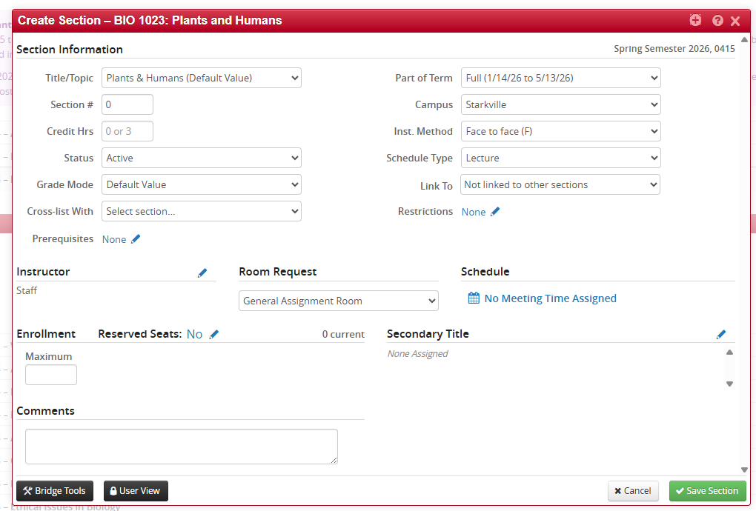
Adding a Section
Find the course you want to add & double click. That will expand the course to show all existing sections of that course for the current term. Then click the green plus sign to open a section creation box.

Slide 25
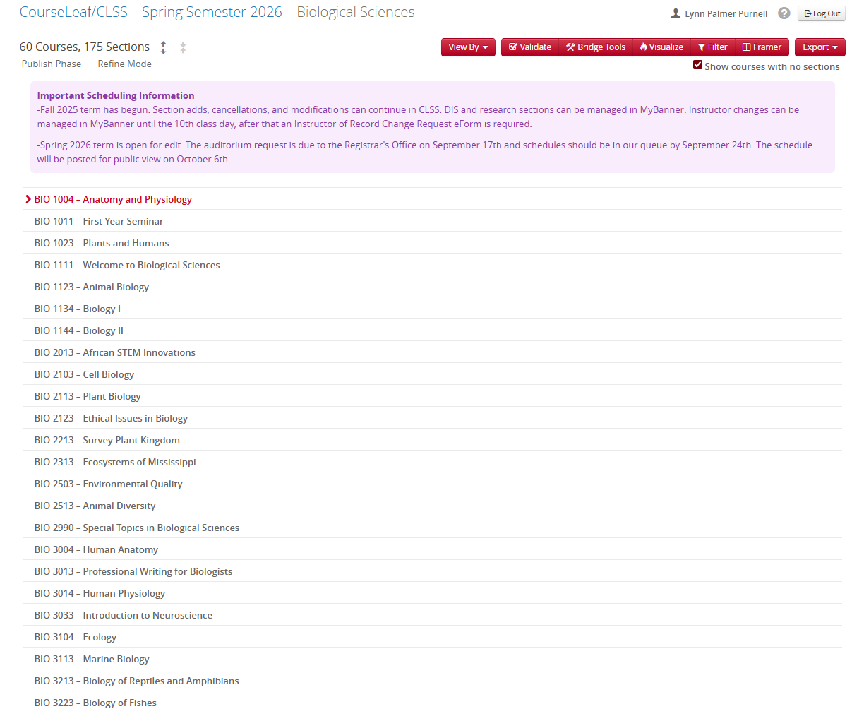
Adding a Section Continued-Course Not Showing
If you cannot find an approved course, make sure to click “Show courses with no sections” in the top right while in your scheduling unit. By default, the system only displays courses that currently have sections attached when you first open your scheduling unit for a given term.
Selecting “Show courses with no sections” will populate the full list of courses in your catalog for that unit. If a course is still moving through UCCC and has not yet been placed on a change notice, it will not appear in the system yet. All other approved courses should display once that option is selected.

Slide 26
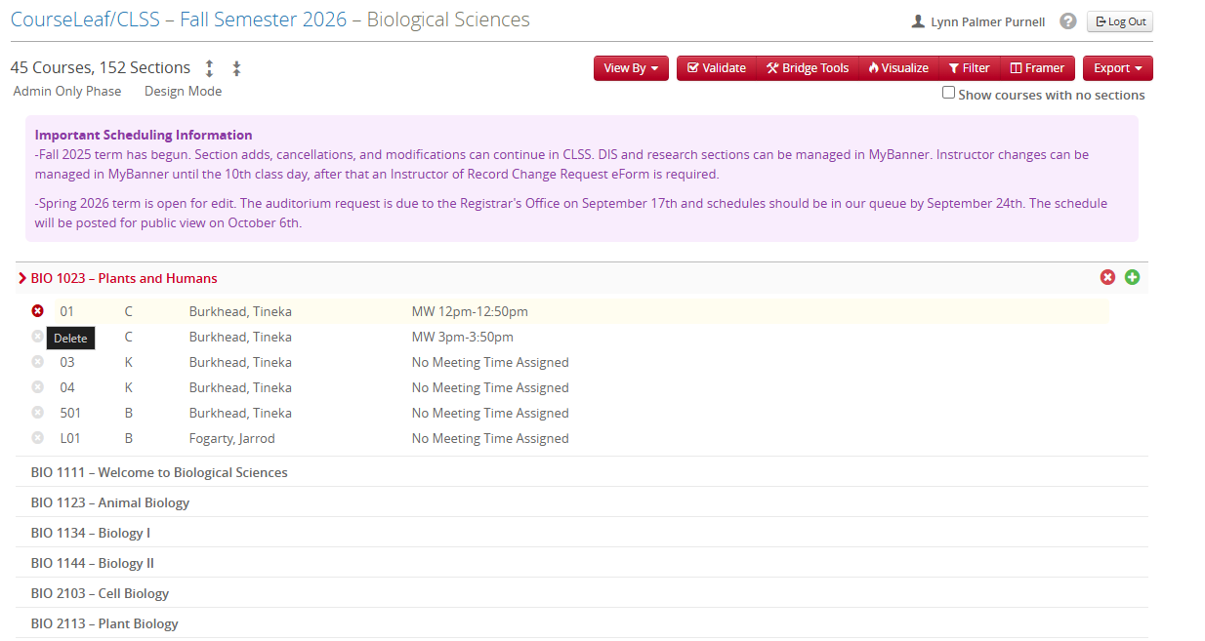
Deleting a Section
Find the course & double click. That will expand the course to show all existing sections of that course for the current term. Then click on the red X to the left of the section. Please note that clicking the X on the right will delete ALL current sections for that course. DO NOT do this unless you really want to remove them all. Once it’s done, we can’t get them back.
** Remember once we get to the publish phase, you can no longer delete a section, you must cancel it

Slide 27
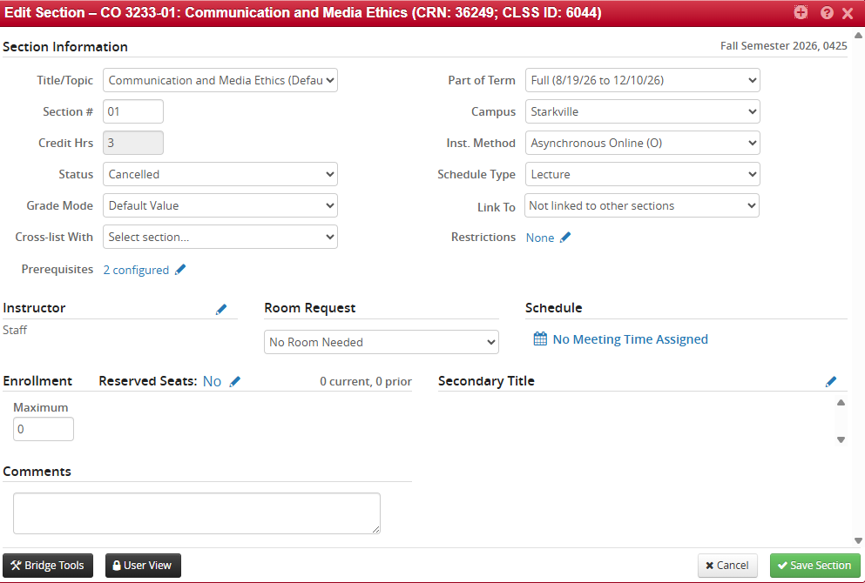
Cancelling a Section- Proof Phase and Beyond
Cancelling a section requires setting the status to cancel, removing the days/times, setting the room request to no room needed, and setting the instructor to staff. CLSS will not save unless all of these are done.

Slide 28
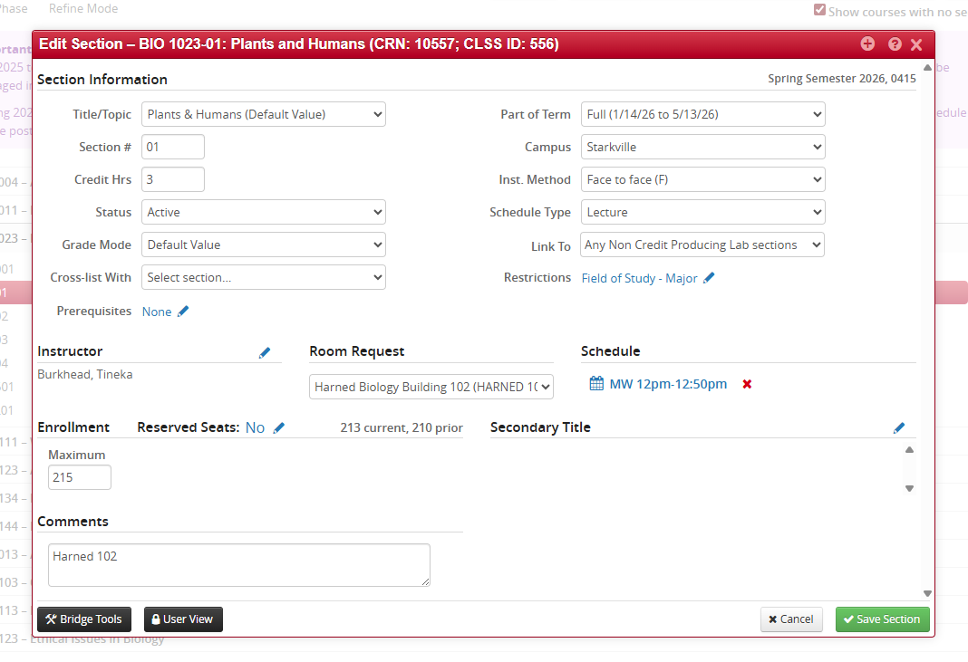
Editing a Section
Find the course & double click. Again, that will expand the course to show all existing sections of that course for the current term. Then double click on the section you want to edit.

Slide 29
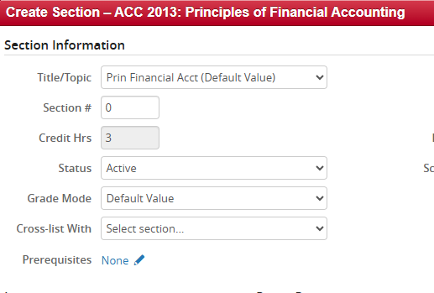
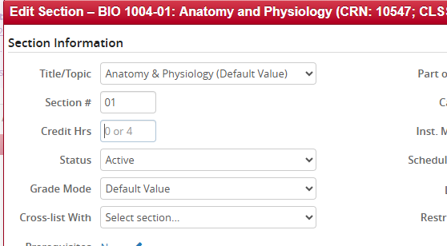
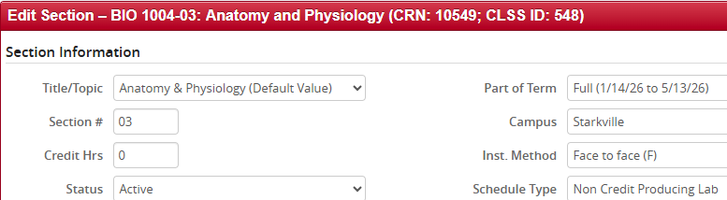
Credit Hours
Items with "or" require a specific amount to be entered. For example, a lecture paired with a non-credit hour lab should be assigned the total number of credits available for the entire class.
Some credit hours are not editable. They will only ever be that set credit hour.
A non-credit producing lab section must be set to zero hours.

Slide 30
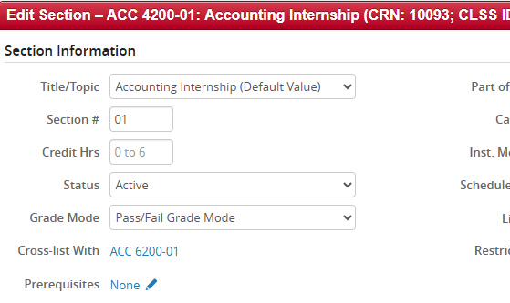
Variable Credit Hours
If you intend students to select their own hours, LEAVE BLANK. If you put a number in the credit hours box, a student will not have the opportunity to change their hours at registration.
*If you go back and assign a set credit hour, Banner won’t automatically update it for students who were already enrolled before the change is made. Their credit hours will stay as they were at the time they registered.

Slide 31
Instructor Changes

Slide 32
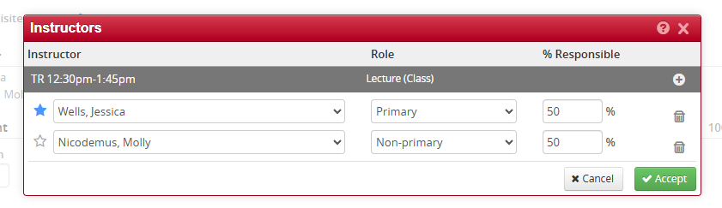
Changing Instructor
Enter instructor name(s) or select “Staff”.
“% Responsible” – must equal 100%
  Primary is for instructors who will enter final grades and are evaluated
Blue star also designates primary

Slide 33
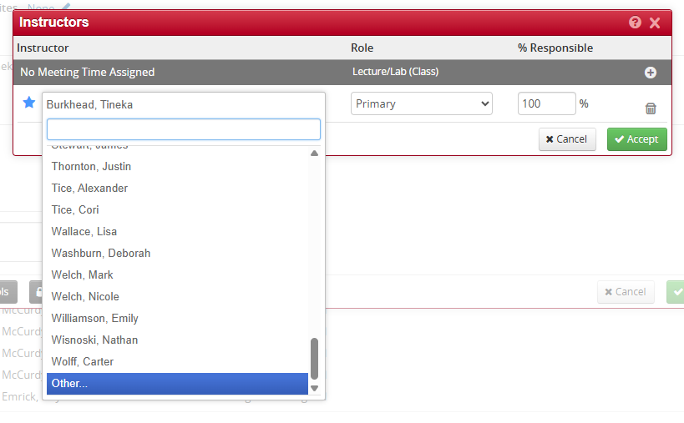
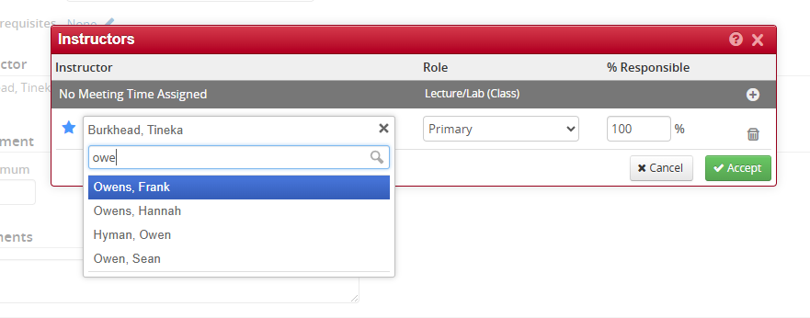
Changing Instructor Not on Your List
If an instructor is not on your list and belongs to another department, you can find them by selecting “Other” and searching their name. Our office used to put an instructor on each faculty list so they could be assigned in myBanner if need be. We are going to clean up the instructor assignments and Emily, and I are now going to only assign instructors to their home department, since any instructor can be assigned in CLSS. If a department decides to assign an instructor to their section outside of their home department and can’t use CLSS, they'll need to come through our office.

Slide 34
Adding Section Restrictions

Slide 35
Adding Restrictions
These can be changed per section. You either INCLUDE (valid for) a group or EXCLUDE (not valid for) a group. Include means only that group can register. Exclude means everyone else BUT that group can register. Some of these types of restrictions are:
Major or Concentration
  Must be either major or concentration, it can’t be both
Level-Grad or undergrad
Classification-Freshman, Sophomore, Junior, or Senior
Campus
  Campus 1 students will automatically get an error when trying to register for a Campus 5 section and vice versa.
  Campus 5 student can only register in only campus 5,8 sections
  Campus 6 student can only register in campus 6 sections
    All Campus 6 sections must get the “Include” 6
Attribute-Honors or FYE

Slide 36
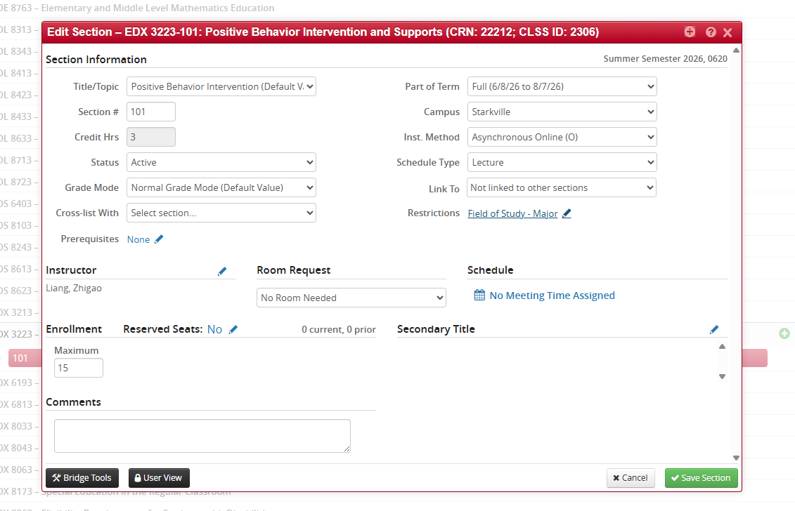
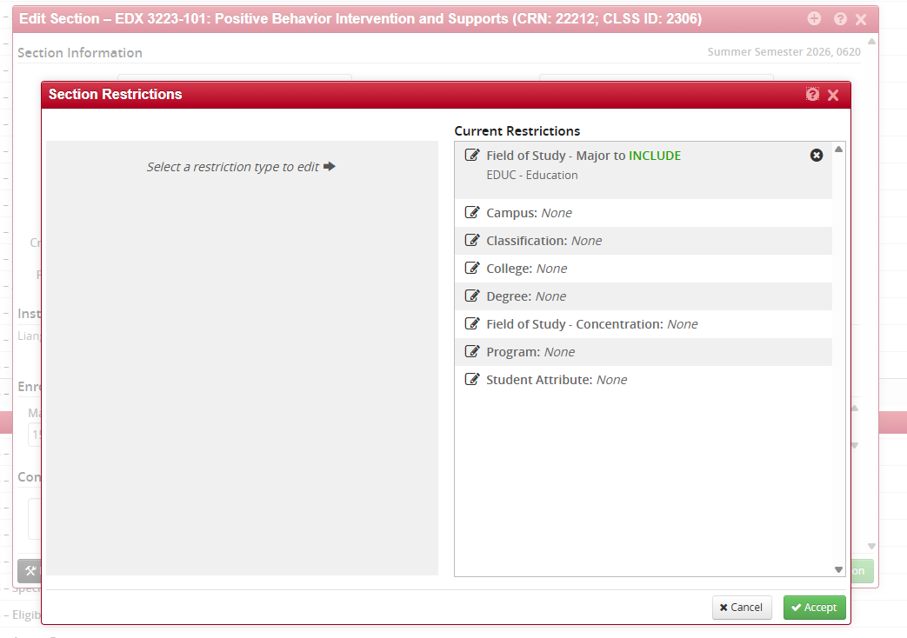
Adding Restrictions
You will click on the pencil icon on the left of the type of restriction you want to add.

Slide 37
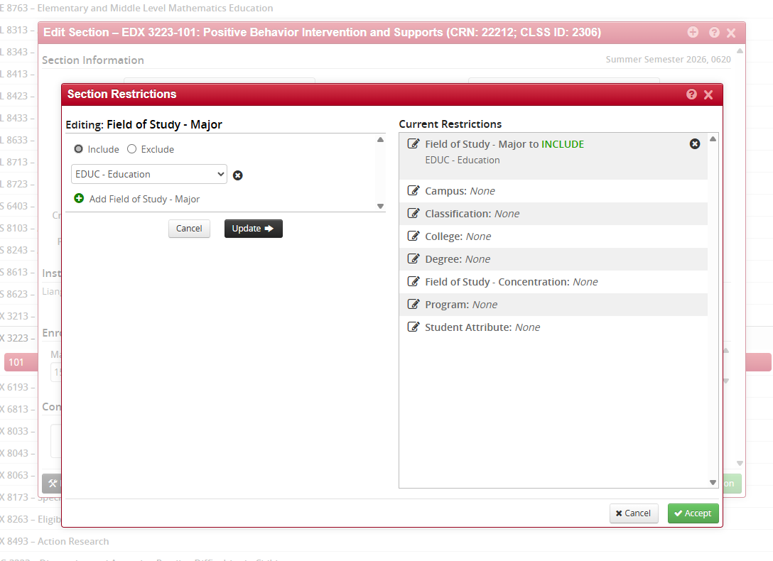
Adding Restrictions
Step 1: Choose whether to include or exclude the group to control registration access to the section.
Step 2: Click the dropdown menu and search for the group’s identifier.
Step 3: To add more groups, click the green “+” button and search for the next group.
Step 4: After selecting all desired groups, click “Update.”
Step 5: Click “Accept.”

Slide 38
Adding Meeting Days & Times

Slide 39
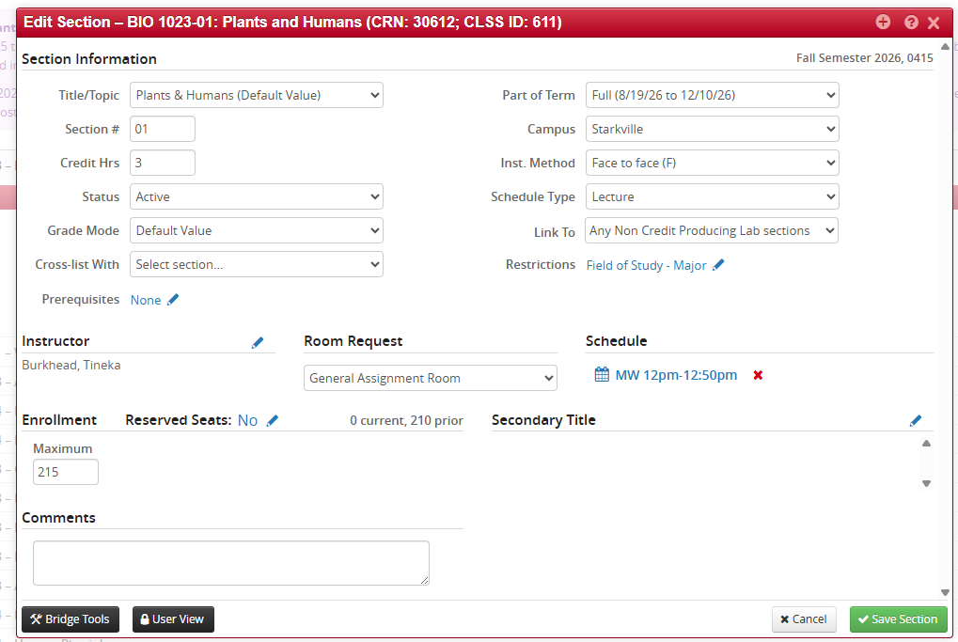
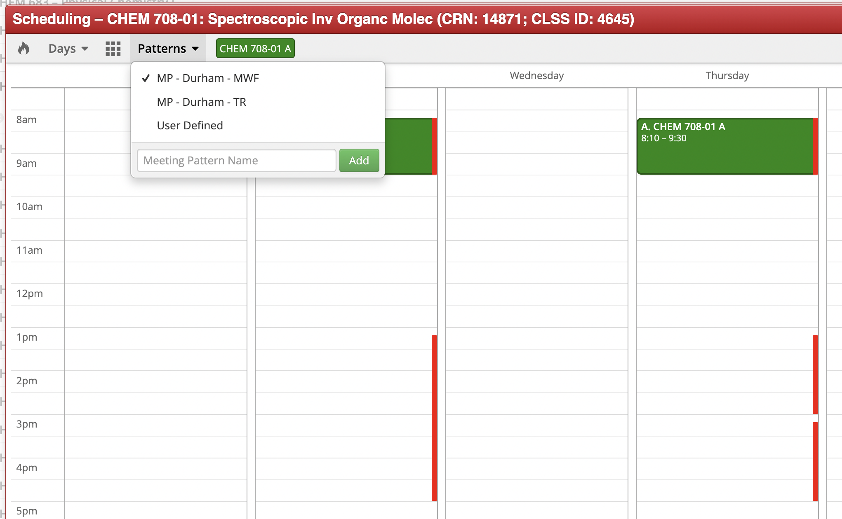
Meeting Days & Times (Snapper)
Clicking ”Meeting Days & Times”
in “Edit Section” box opens the Snapper
Screen.

Slide 40
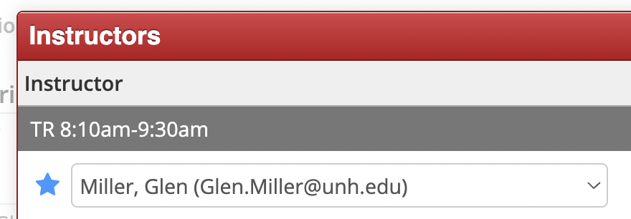
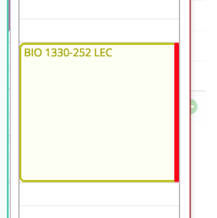
Meeting Days & Times (Snapper) cont’d
The bold Red Line in Snapper indicates when the primary instructor is already assigned to another section during that time. This doesn’t mean you can’t select it; it’s just a notification feature.

Slide 41
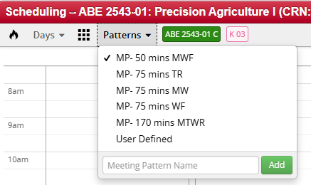
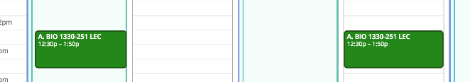
Meeting Patterns (Snapper)
Hover mouse over the designated time slots denoted by grey boxes with dotted lines.
Select desired slot & the time(s) show confirmed by a solid green box.

Slide 42
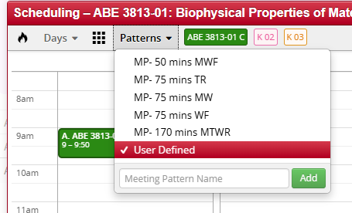
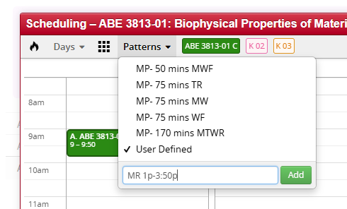
User Defined Meeting Pattern (Snapper)
You can create a custom meeting pattern by selecting the “User Defined” Option
When entering the desired days and times use “a” or “p” to define a.m. or p.m.
Example: 11a-1p
*This is for sections that ARE NOT three- credit hour lectures & seminars.

Slide 43
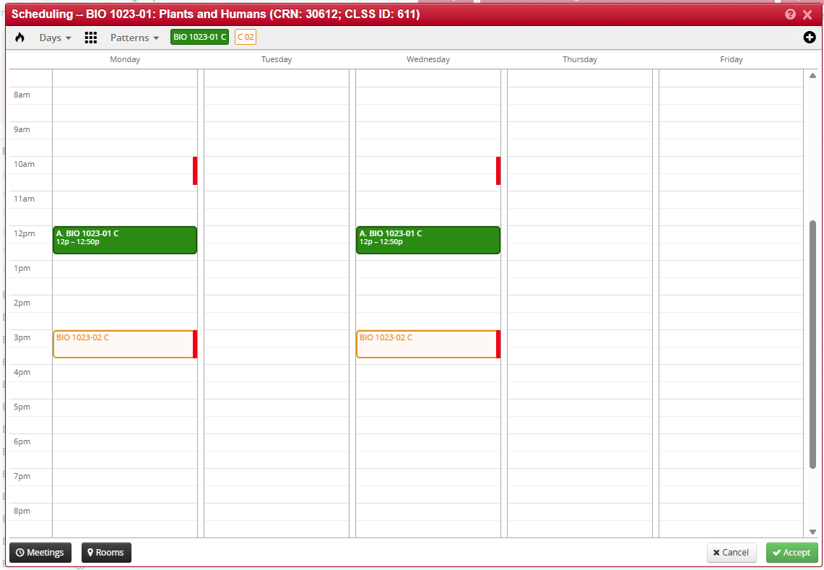
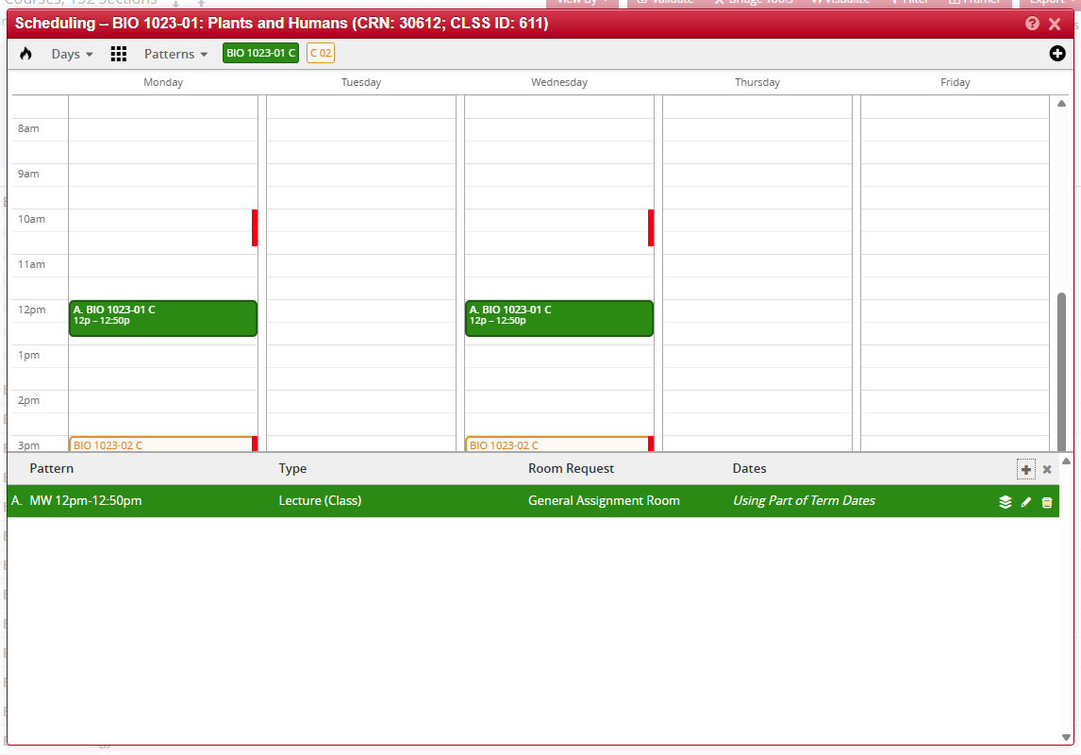
Multiple Meetings (Snapper)
Step 1:
To add additional meeting times, select the black “Meetings” icon in lower left corner of Snapper.
This will reveal a line item of the first pattern.

Slide 44
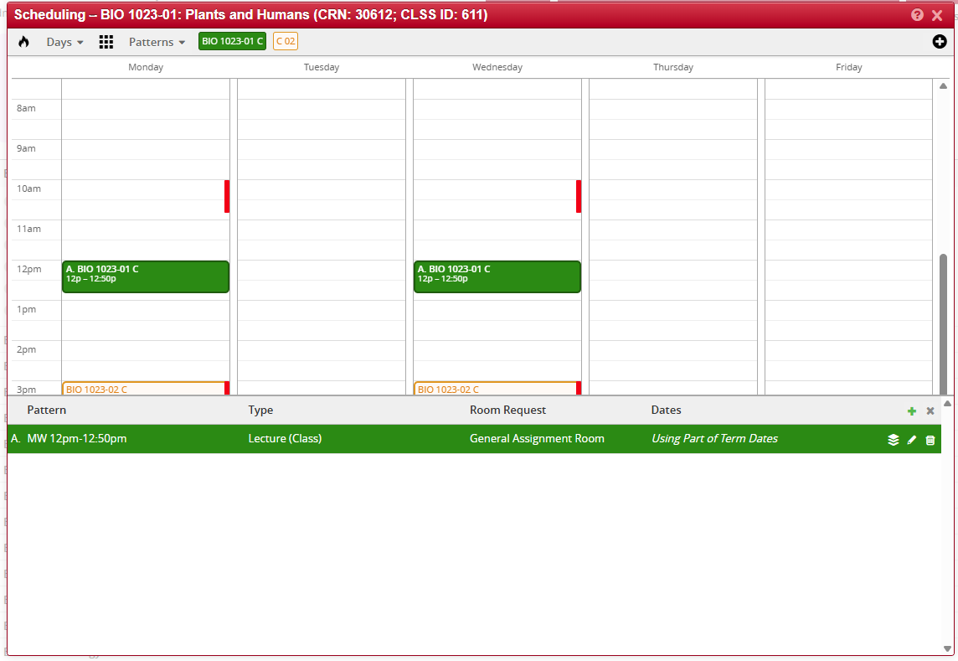
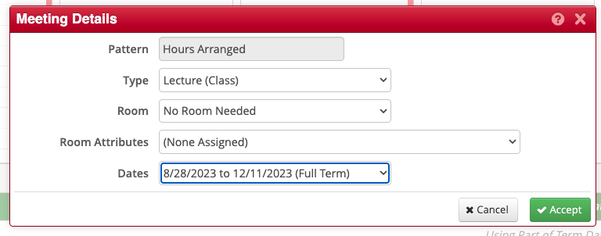
Multiple Meetings (Snapper) cont’d
Step 2:
Click on green plus sign just above the line item.
Step 3:
Fill in Meeting Details.
Click “Accept”.

Slide 45
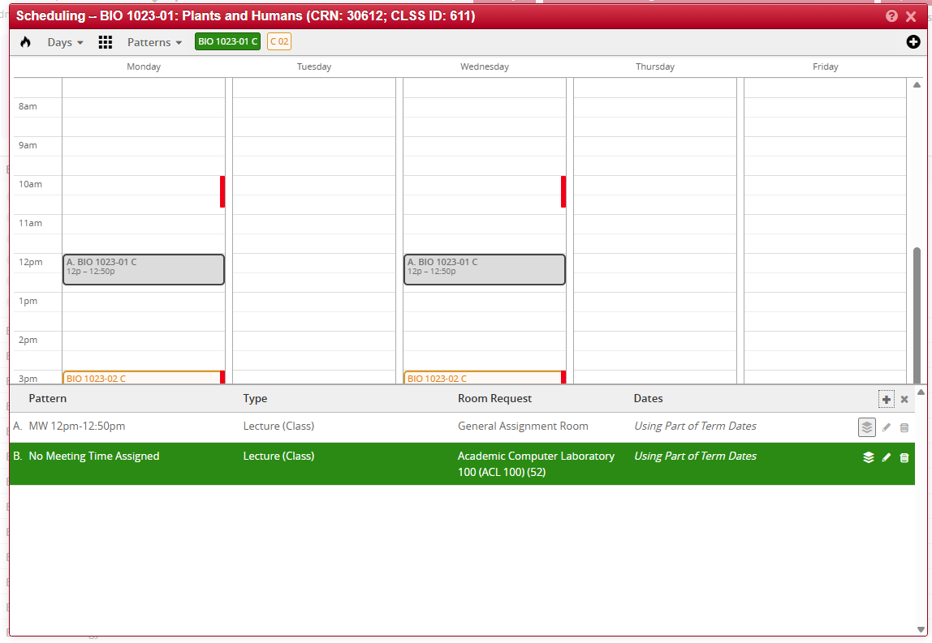
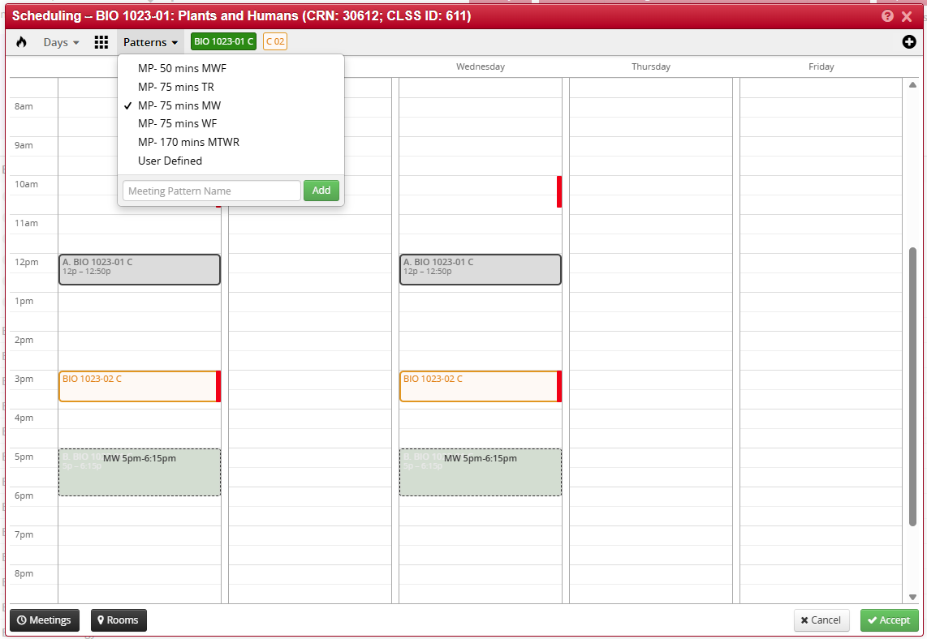
Multiple Meetings (Snapper) cont’d
Step 4: Select the new meeting pattern line (note the bottom box will disappear)
Step 5: Select the new meeting pattern you want OR use the “User Defined” option then click “Accept”

Slide 46
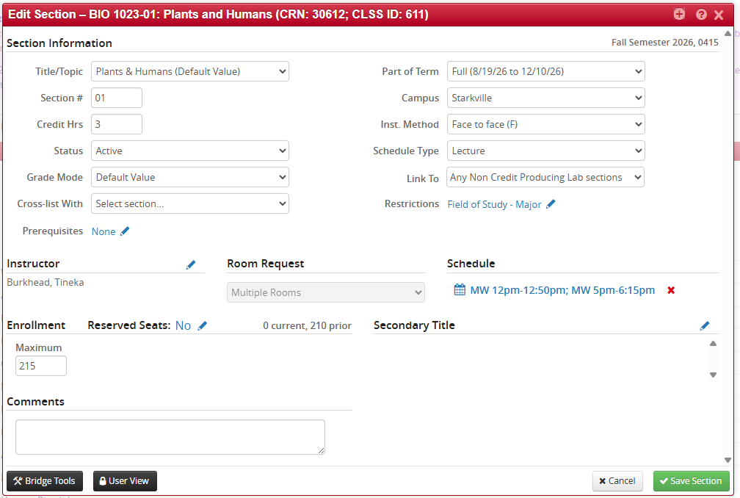
Multiple Meetings (Snapper) cont’d
After clicking “Accept,” both meeting times will appear in the Edit Section box and be identified as ”Multiple Rooms”.

Slide 47

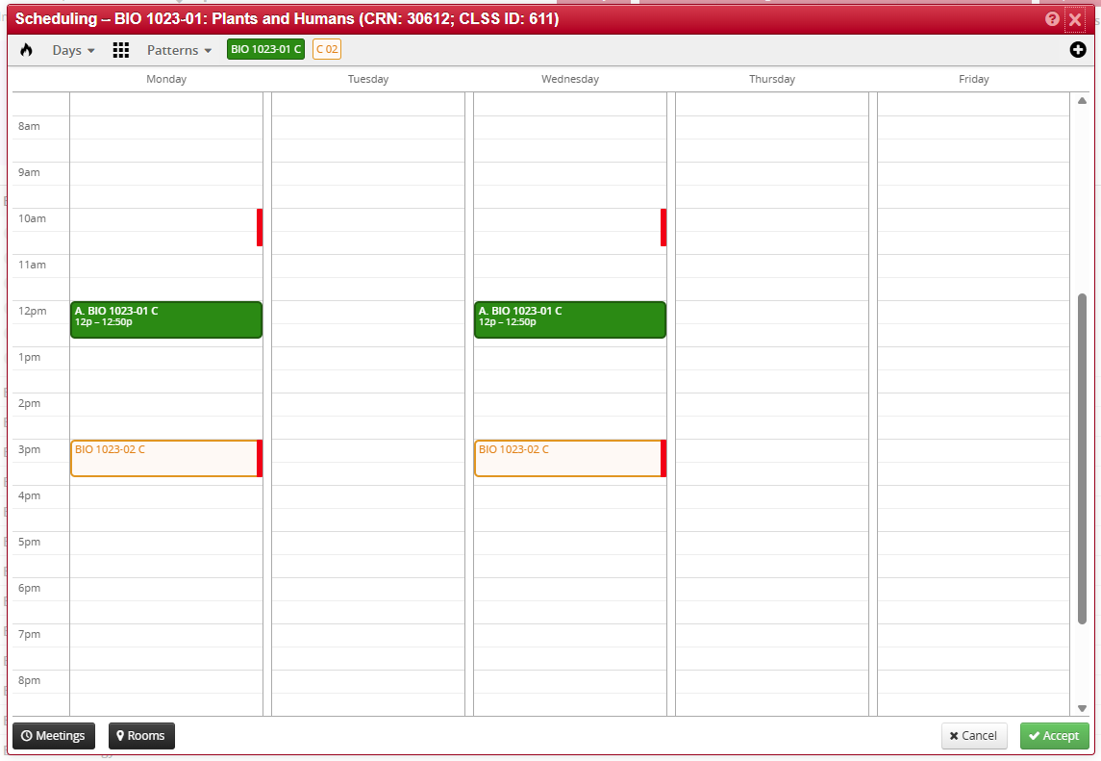
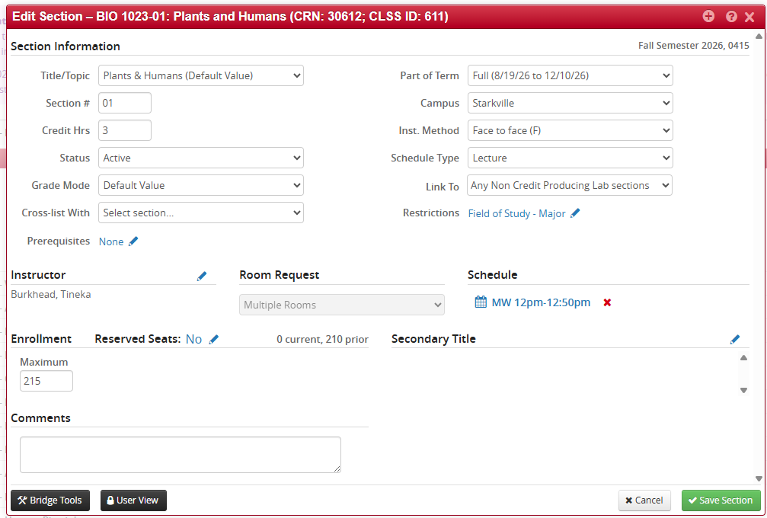
Multiple Meetings (Snapper) cont’d
If you want your second line to be listed as TBA and not follow a meeting pattern, first add the second meeting line. Then click the small “X” and select “Accept.” Keep in mind that a TBA line will not appear in the edit box, but it is still applied. You can confirm this because the Room Request will display as “Multiple Rooms.”

Slide 48
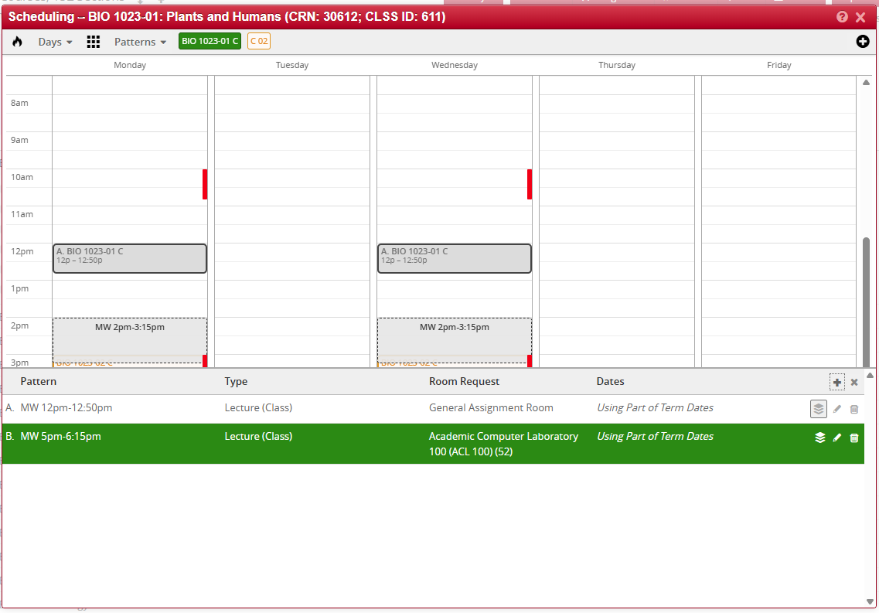
Multiple Meetings (Snapper) cont’d
You can also remove a meeting line that already exists by clicking the trash can & hitting “Accept”

Slide 49
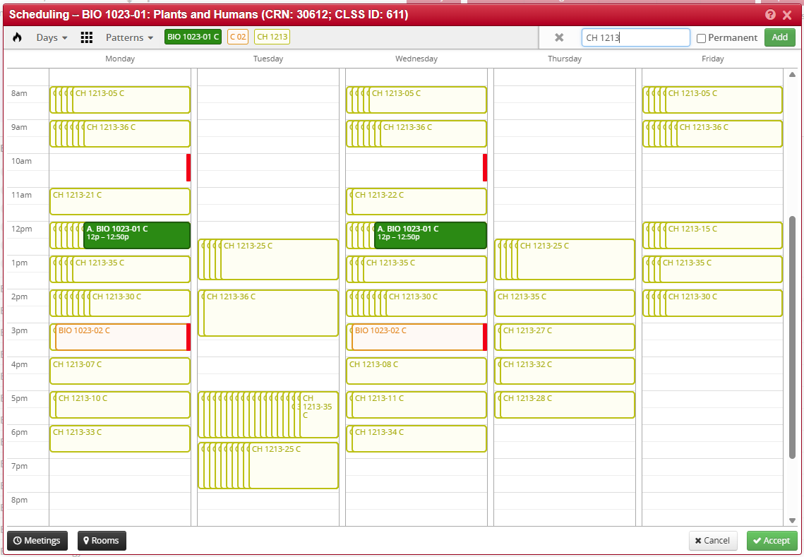
Comparing Class Times (Snapper)
You can also compare your course with any other sections already on the schedule from any scheduling unit. However, do not select “Permanent”—unless you intentionally want the system to always compare these courses.

Slide 50
Lecture/Labs & Linked Lectures w/ Non-Credit-Producing Labs

Slide 51
What’s the Difference?
Feature | Lecture–Lab Combo | Lecture + Linked Non-Credit Lab
Credit hours placed on the lab portion | ✔ Yes-One section so credit is on that section | ✘ No-Credit is placed on the lecture
Registration | Register for one combined section | Two separate registrations (lecture + lab)-Can’t register for one without the other
How it appears in scheduling | One section with multiple meeting patterns | Standalone lecture sections linked to multiple lab options

Slide 52
When Should I Use Which?
A lecture–lab combo is the better choice when:
✅ You want students to register only once, and you are offering only one lab time (not multiple to choose from)
A combo simplifies registration: students enroll in one CRN, and both lecture and lab appear automatically.
Linked non-credit labs are the better option when:
✅ Multiple lab times must be offered for scheduling flexibility
Linked labs let students choose from several meeting options.

Slide 53
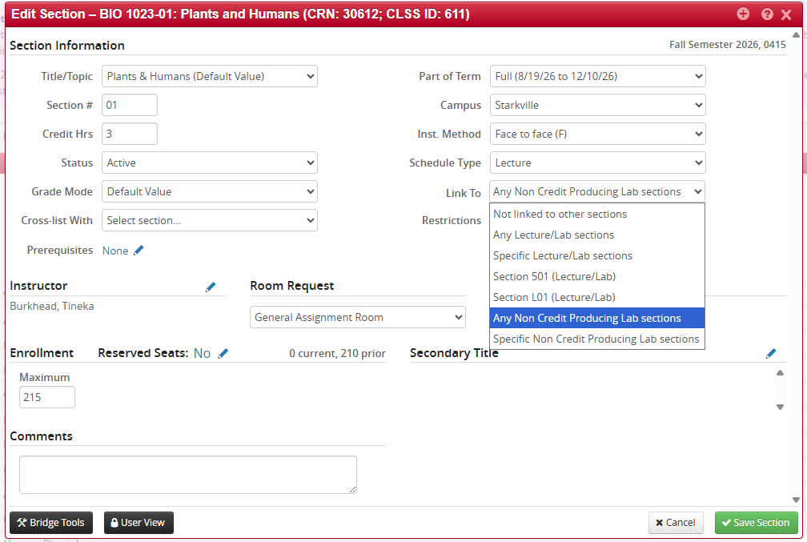
Linking a Lecture to a Lab
It’s best to select any non–credit-producing lab sections when linking a lecture. Choosing specific labs can cause the linking numbers in Banner to become misaligned, which may corrupt the link and prevent the system from requiring students to register for both components.

Slide 54
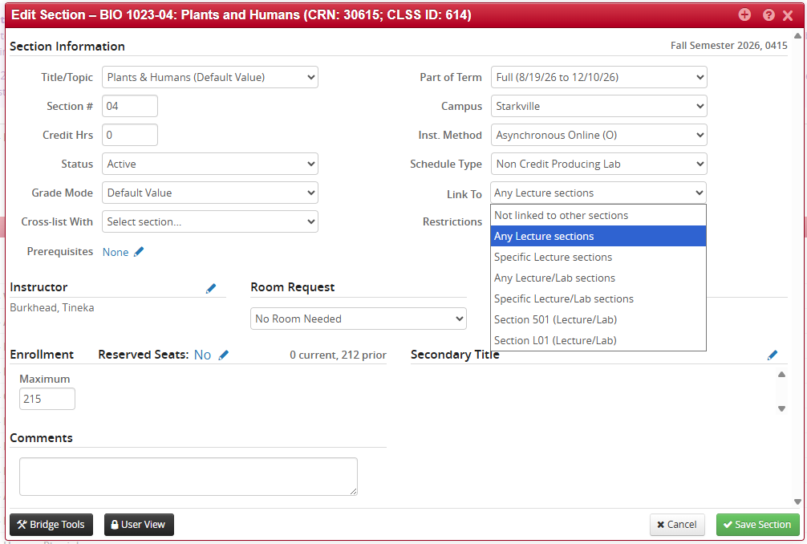
Linking a Lab to a Lecture
The same goes for the lab. It’s best to select any lecture sections when linking a lab. Choosing specific lectures can cause the linking numbers in Banner to become misaligned, which may corrupt the link and prevent the system from requiring students to register for both components.

Slide 55
Linking is IMPORTANT
It is critical that the lecture and all associated K-labs are properly linked in the system. Linking ensures that students cannot register for one without the other and prevents incomplete or incorrect enrollments. When the components are not linked:
Students may register for the lecture but miss the required K-lab.
They may register for a K-lab that does not correspond to the correct lecture section.
The system cannot enforce the requirement, which leads to registration errors, student confusion, and manual fixes later in the term.
When the lecture and K-labs are linked:
The system automatically guides students to select both components.
Registration proceeds smoothly with far fewer errors.
Student schedules reflect the correct instructional time and required activities.
Advisors and departments do not need to troubleshoot mis-registrations after the fact.
In short: linking the lecture with its K-labs is essential to ensure accurate enrollment, prevent conflicts, and maintain the integrity of the course structure.

Slide 56
Cross-Listing in CLSS

Slide 57
Cross-Listing
Cross-listing is the practice of offering one meeting pattern under two or more course numbers or sections so that students register under different departments, programs, or course codes but attend the same class. In short: multiple course identifiers point to the same class.
1. The basic idea
A cross-listed class has one physical meeting (or one online meeting) but multiple course listings.
  Example: ART 4924, EN 4924, & CO 4924 are cross-listed. Students can enroll in any course code, but everyone attends the same sessions and completes the same assignments.
2. Reasons to cross-list
Enrollment management - departments can allocate seats between programs when desired.
Share faculty and resources - one instructor teaches students from multiple majors in one integrated class.

Slide 58


Cross-List Explanation
When cross-listing courses, CLSS has a “Child & Parent” approach
The child section/s (secondary) connects and breaks= to cross-list the child needs to find their dependent to control what they do. I like to think of this like a child is dependent on their parent to control them, so they connect with them, but when they want to emancipate, they disconnect from them.
The parent section (primary) is in charge= they control majority of the section detail (not all) but can’t break from their child. A child is dependent on their parent to control them and what they do. They love their child, so they don’t want to disconnect from them.
This shows on the child section
This shows on the parent section

Slide 59
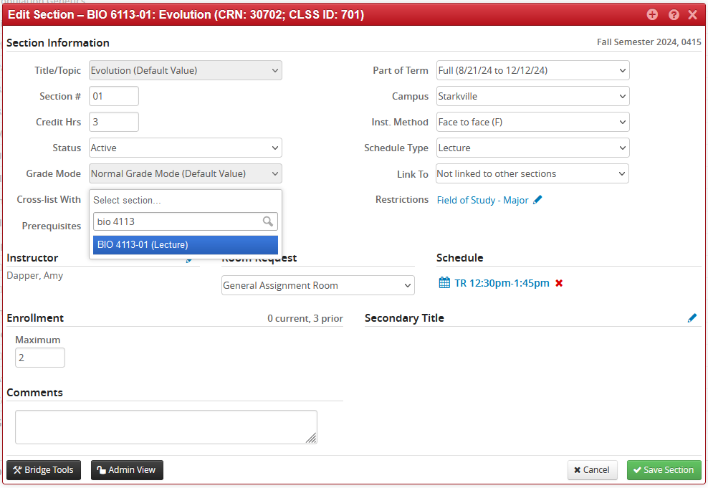
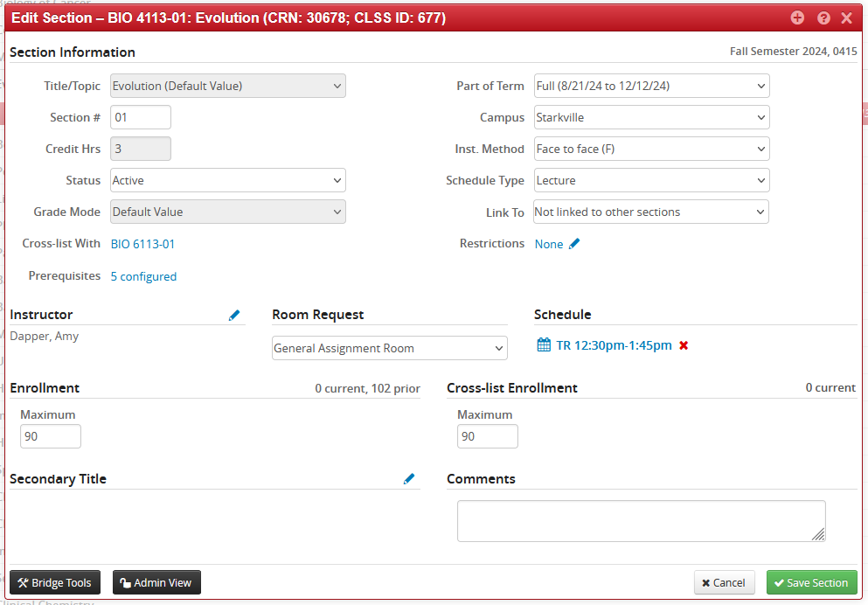
Cross-List Split Level Example
In this case, your department wants to control all the detail information on the 4000 and 6000 courses by using only the 4000 detail
Step 1. Go into the 6000-level section and find the 4000-level section
Step 2. The only details you will control are the status, part of term, instructional method, instructor, room, meeting days & times, and the cross-list max enrollment for all cross-listed sections from the 4000-level

Slide 60
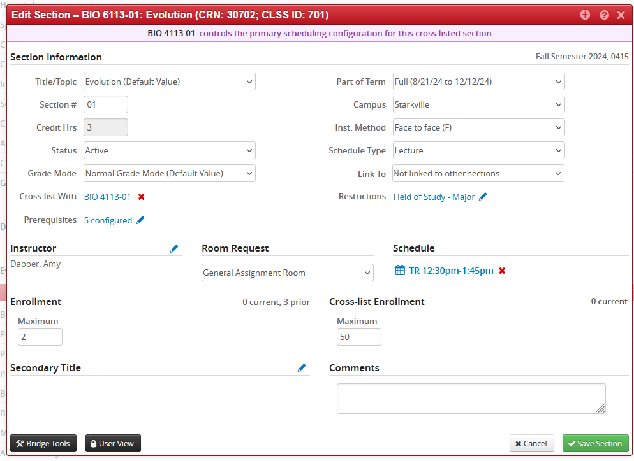
Cross-List Split Level Example
In this case, your department wants to control all the detail information on the 4000 and 6000 courses by using only the 4000 detail
Step 3. If you want to break the connection, you’ll go back to the 6000-level and click the red X seen below. You’ll also see across the top of the “child” that it tells you who is the primary.
*If you click on the BIO 4113-01 link here, you can toggle back and forth from one section to another

Slide 61




Cross-List Across Department Example
In this case, English is providing the instructor, and they need to control the detail from their section. They are the parent. Communication and Art will need to find the English section and connect. They will be the child.
Step 1. Departments should connect through their respective sections (e.g., ART through ART, CO through CO) and then find the EN section. The purple banner across the top of the child/secondary section will show which section is the primary/parent.

Slide 62

Cross-List Across Department Example
In this case, English is providing the instructor, and they need to control the detail from their section. They are the parent. Communication and Art will need to find the English section and connect. They will be the child.
Step 2. The only details you will control are the status, part of term, instructional method, instructor, room, meeting days & times, and the cross-list max enrollment for all cross-listed sections from the parent section

Slide 63
Cross-List Across Department Example
In this case, English is providing the instructor, and they need to control the detail from their section. They are the parent. Communication and Art will need to find the English section and connect. They will be the child.
Step 3. If you want to break the cross-list connection, each department needs to go into their own section to disconnect. This means you’ll go into the ART section as well as the CO section and click the red X seen below.

Slide 64

Changes On Cross-Listed Sections
You cannot edit or cancel something that has it’s cross-listed section already in workflow. Note the banner @ the top.

Slide 65
Cross-Listed Sections Parent & Child
The parent & child relationship with cross-listed sections may change when we roll the schedule from the previous year.
We’ve run into repeated issues with cross-listed courses (parent/child relationships) carrying over incorrectly when rolling the schedule forward. With help from CourseLeaf, we discovered this was largely due to instructors being listed on multiple faculty lists. The home department of the instructor is used to determine who is the parent of the cross listing when the schedule rolls to the next term, but only when exactly one section within the group matches the home department. Example: EN 4403, there are two sections in this group that match the home department (EN 4403 and EN 6403), so CLSS falls back to selecting the parent purely by alphabetical order because there isn’t just one EN section.

Slide 66

Unsupported Cross-Listings
Because cross-listed sections are defined as sections that share the same status, meet at the same time, have the same instructor, and are held in the same room, any sections that do not meet all of these criteria will no longer be supported. If that happens, you’ll need to contact the Registrar’s Office to have the changes made in Banner. It’s important to keep all cross-listed sections fully aligned—any differences can make them unsupported, which then prevents editing in CLSS. If you need to change something for one section but not the other, it’s best to disconnect the cross-listing beforehand.

Slide 67
Cross-List Maximum Enrollment

Slide 68
How Cross List Maximum Enrollment Works
When courses are cross-listed in CLSS or Banner, they share a combined (cross-list) maximum enrollment in addition to their individual section capacities.
Each individual section has its own maximum enrollment, which limits how many students can register for that specific section.
The cross-list maximum sets the total number of students allowed to enroll across all sections in the cross-list group.
For example:
PSY 4223-01 has a max of 60
PSY 6223-01 has a max of 5
The cross-list max is set at 60
Even though the individual sections total 65 seats combined, only 60 students total can enroll between both sections. Once that shared limit is reached, registration will close for all sections in the cross-list, regardless of whether one section still shows open seats.
This setup helps control overall class size while still allowing departments to manage section-level enrollments independently.

Slide 69

Section Capacity vs. Cross List Capacity
Here is a visualization of the example on the previous slide. Only 60 students total can register across both sections. This means if 60 undergraduates enroll in 4223, no graduate students can register for 6223, since the cross-list maximum enrollment — the total allowed across all linked sections — is 60. To allow each section to reach its individual capacity, the cross-list maximum should have been set to 65.

Slide 70

Section Capacity vs. Cross List Capacity
Cross List Max Enrollment: In this example, only 25 students in total can register across both sections. The department doesn’t differentiate between graduate and undergraduate enrollment, so once the combined total reaches 25, registration closes. This could mean 10 students in IE 4733 and 15 in 6733, or 20 in IE 4733 and 5 in 6733. Although it may appear that seats are still available in one section, they’re not — the department has set the cross-list maximum (the total allowed across all linked sections) at 25.

Slide 71

CLSS Cross-List Totals in Design Mode
When two or more sections are cross-listed, CLSS automatically combines the maximum enrollment for each section unless it is manually adjusted through the parent section. Referring to the IE section on the previous slide, if the parent section’s cross-list enrollment had not been changed to 25, it would have defaulted to 50.

Slide 72
CLSS Cross-List Totals in Design Mode
Step 1. Go into the child (secondary) section and cross-list with the parent (primary) section and hit save section.
Step 2. Return to the parent section, update the cross-list enrollment to your desired number, and save section. In this example, it would have been 92 (90 for 4113 and 2 for 6113), but it was changed to 90 total.

Slide 73
CLSS Cross-List Totals in Refine Mode
Changing the cross-list enrollment in Refine Mode requires a few extra steps if you do not want the combined enrollment of each section to be used as the cross-list total. Since you have to cross-list starting with the child, and the child doesn’t control the cross-list information, CLSS will automatically combine the maximum enrollment across all sections to get the cross-list total.

Slide 74
CLSS Cross-List Totals in Refine Mode
Step 1. Go into the child (secondary) section and cross-list with the parent (primary) section, hit save section, & start workflow. You must then wait until the section is approved and out of workflow.
Step 2. Return to the parent section, update the cross-list enrollment to your desired number, save section, and start workflow. In this example, it would have been 92 (90 for 4113 and 2 for 6113), but it was changed to 90 total.
*If your cross-listings are across departments, you must contact the parent scheduling unit to adjust the cross-list maximum enrollment on the primary section once your section has cleared workflow.

Slide 75


CLSS Cross-List Totals in Refine Mode
Please note: if you are utilizing waitlist, you can adjust the cross-list enrollment using myBanner’s “Update Max Enrollment for Cross-Listed Sections” feature. To use this option, all sections must be within your scheduling unit.
If you are not using a waitlist, your cross-listings span multiple scheduling units, or you need the cross-list enrollment changed quickly, note your desired maximum in the comments. We can update it after bridging.

Slide 76
Updating Max Enrollment
Remember, you can’t update enrollments in myBanner if:
Trying to add or reduce the max enrollment below 10.
A room isn’t assigned. This means you can’t go up or down in the enrollment.
Cross-listed courses ( if you aren't utilizing waitlist).

Slide 77
Reserved Seats

Slide 78
CLSS Reserved Seats
Reserved Seats allows schedulers to set aside seats within each section for specific student groups for a designated period.
These configurations are set up and controlled by the Registrar Curriculum & Scheduling Team.
To create a configuration, you’ll need to request this by email through MasterSchedule@registrar.msstate.edu.
Departments will only be able to use the reserve seat configurations that have been set up and assigned to them; they won’t be able to add any others.
Groups can be configured by:
  Campus
  Field of Study (Major or Concentration-Can Only Add One of Either)
  Attribute
  Classification (Fr, So, Jr, or Sr)
  College
  Degree
  Department
  Program
  Admission Term

Slide 79
CLSS Reserved Seat Fields
Group – This is where schedulers select the group label that administrators set.
Maximum – This is the enrollment maximum for each group of students.
Allow in Unreserved – This field is a Yes or No field which when set to Yes allows students in this group to register under the unreserved seats once the maximum for the reserved has been reached.
Max Cap Expiration – This is the expiration date that can be associated with the reserve. If no students have registered by the date indicated, the reserve row will delete in the morning with the daily refresh. If students have registered, the enrollment max of the reserve drops down to match the total number of students registered on the reserve.
*When a scheduler saves a reserve, the general maximum enrollment fields on the first edit section screen form will no longer editable.

Slide 80
Reserved Seats vs Restrictions
- When a section uses both section restrictions and reserved seats, do not assume that Banner will combine eligibility criteria across the two configurations.
- If a reserved seat group is intended for a specific population, the reserved seat requirement group should independently define the complete eligible population. Do not rely on section restrictions to provide part of the eligibility.
Example
If reserved seats are intended for Honors freshmen with the FYE attribute, we will need to configure the reserved seat requirement group to include all applicable criteria:
Freshman classification
FYE attribute
UH or UHP attribute
Do not configure it as:
Section restriction = UH or UHP
Reserved seat group = Freshman + FYE
-Banner may evaluate section restrictions and reserved seat requirement groups independently and may not combine criteria from separate configurations when determining eligibility for reserved seats. Defining the complete target population within the reserved seat requirement group helps ensure students who meet the intended criteria can access the reserved seats.

Slide 81


Setting Reserved Seats on Sections (After you Request a Configuration)
Step 1. Click the edit pencil next to the Reserved Seats field.
Step 2. A dialog box opens to make changes to the seats on the section. The box contains two tabs. To add a group, click the Plus Sign.

Slide 82

Setting Reserved Seats on Sections Cont. (After you Request a Configuration)
Step 3. Scroll down to see which reserve groups are available for your scheduling unit. If the group you need isn’t listed, please request it by emailing MasterSchedule@registrar.msstate.edu.
- Add the maximum number of students for that group.
- Whether you want them to be allowed to continue to register once all reserved seats are taken.
- Expiration date you want the reserved seats to fall off.

Slide 83



Reserved Seats After Registration
The reserved seats for this section were added on 10/29, but three Meridian students had already registered before that date. Because of this, those students weren’t included in the reserved seat count once the restriction was applied.
Reserved seat settings only apply from the point they’re added onward—they don’t retroactively include students who were already enrolled in that cohort.

Slide 84


Reserved Seats Expiration Example
If no students have registered by the date indicated, the reserve row will delete in the morning with the daily refresh. If students have registered, the enrollment max of the reserve drops down to match the total number of students registered on the reserve.
*Once a seat is taken from the reserved seat option, the group grays out and can’t be removed.

Slide 85


Reserved Seats Expiration Exception
Scenario: Although the expiration date passed for this reserved seat group, the system did not recalculate the reserved capacity based on actual registration. With only 10 Kinesiology majors enrolled prior to the deadline, the reserved seat limit should now reflect 10 students, and the remaining 2 seats should have been released into the unreserved category.

Slide 86
Reserved Seats Expiration Exception Explanation
After the reserved seat expiration date passed, the reserve group was at full capacity with all 12 seats occupied by Kinesiology majors. Because no seats remained unfilled at that time, none were released to the unreserved pool, and CLSS did not need to make any enrollment adjustments. Since reserve expirations are only processed once, it is likely that two Kinesiology students dropped the course after the expiration date, leaving two open seats still within the reserved group.

Slide 87
Enrollment Management Strategy
We have found that waitlisting does not work well when combined with reserved seats. When using reserved seats alone, enrollment numbers can be adjusted, and capacity overrides can be granted as needed. However, once waitlisting is also enabled, capacity overrides cannot be granted if the reserved seat counts become misaligned. Enrollment control really needs to be one approach or the other. Waitlisting and reserved seats introduce competing controls, and using both simultaneously creates conflicts rather than flexibility. You should only apply ONE “enrollment management strategy” at a time.

Slide 88
Room Assignments, Room Requests, & the Comments Box

Slide 89
Room Scheduling Challenges
Important things to remember when requesting a room:
Rooms are assigned based on actual enrollment and space efficiency. Please provide realistic numbers—do not inflate enrollment to obtain a larger room. Also, do not decrease needed enrollment to have a certain room or stay in the building.
Room availability may change due to renovations, lost seating, reallocated spaces, or specialized furniture/equipment.
Non-standard meeting patterns (once per week, irregular times) and location preferences limit available space.
Enrollment changes after assignments, over- or under-estimating need, and late adjustments often require room reassignment. Try to be proactive, not reactive.
Instructor scheduling preferences (e.g., two-day format, back-to-back classes of different sizes) can impact room options.
Room assignments remain fluid until the semester begins and may change as needs shift.

Slide 90

Room Request & Comments Box
PLEASE DO NOT select “No Room Needed” if you actually intend to have a room assigned. Selecting “No Room Needed” while also placing a room request in the comments creates conflicting information. We rely on the “No Room Needed” selection when building room assignment reports. Sections marked this way are pulled into a spreadsheet indicating that no space should be assigned. If a section is listed this way but later needs a room, it will likely be among the last sections we are able to accommodate. If you select “No Room Needed,” you don’t have to put it in the comments as well.

Slide 91

Comments Box
Here are the things you should list in the comments box in CLSS:
Room request- specific specialized room assignments, room preferences, and specific instructional needs.
  Instructors teaching back-to-back
  Tech room needed
  Moveable desks, tables, or chairs needed
Any fees that are associated with the course and need to be added. Our office can’t keep up with all extra fees, so we rely on the department to tell us. Don’t worry about distance fees, they’re embedded in my brain!
  Please be sure to include your fee code and amount
*This is not visible to the public so include anything you want us to know.
**Also, any room changes need to come from you to our office, not directly to us from the instructor.

Slide 92
Waitlisting

Slide 93
Waitlisting-Not Done in CLSS
Capacity overrides cannot be used when waitlisting is enabled.
Waitlisting is only available for Campus 1 courses.
  If you cross-list across campuses 1 and 5, you cannot have a waitlist.
It can only be applied to undergraduate sections.
Linked lecture/lab sections are not eligible for waitlisting.
A student can join the waitlist only when no seats are available.
Students who do not meet prerequisite requirements will not be able to join the waitlist.
Students can only be on one waitlist for a course.
Students may join the waitlist for a different section of the same course, even if they are already registered in another section.
When a seat becomes available, the student will receive an email and have 24 hours to register.
If a student misses their 24-hour registration window, they must rejoin the waitlist.
For split-level courses, only the undergraduate section(s) may use waitlisting.
To set waitlist priorities, departmental users must submit a myBanner Access Request eForm and note “REGISTRATION WAITLIST DEPARTMENTAL” in the Other description field.

Slide 94
Enrollment Management Strategy Re-Emphasized!!!
We have found that waitlisting does not work well when combined with reserved seats. When using reserved seats alone, enrollment numbers can be adjusted, and capacity overrides can be granted as needed. However, once waitlisting is also enabled, capacity overrides cannot be granted if the reserved seat counts become misaligned. Enrollment control really needs to be one approach or the other. Waitlisting and reserved seats introduce competing controls, and using both simultaneously creates conflicts rather than flexibility. You should only apply ONE “enrollment management strategy” at a time.

Slide 95
Comparing Current & Previous Scheduling Terms

Slide 96


Schedule Framer-Viewing Past Offerings
When you click “Framer” CLSS automatically pulls the summary view of your course offering the last three terms.

Slide 97


Schedule Framer-Viewing Past Offerings
1. To change the terms you’re viewing, you must click “View” & Customize
2. Then check the terms you want to compare to one another. If you want to view three terms at once, you must select three columns at the bottom!

Slide 98


Schedule Framer-Viewing Past Offerings
3. You can select to look at a standard view or detailed view of these terms by clicking “View” again.
A detailed view shows you how many sections you taught, who taught them, the time they taught, and how many seats you offered, not how many actually enrolled.

Slide 99
Schedule Framer-Viewing Past Offerings
4. You can also add a section of that course through the framer.

Slide 100
Validating Schedule/Section

Slide 101



Alerts to Know
Error
Can’t Save/Submit to Workflow
Workflow
Can submit to Workflow/ Notification to be Reviewed by Approver/s
Warning
Can Save/Submit to Workflow, but Proceed with Caution
Notes:
What a user sees, when…
Saving, or submitting, a section
Validating a Scheduling Unit
Error – You cannot save until this is resolved.
Warning – You can save, but do so with consideration.
Workflow – The choices that you’ve made will need to go through the approval process.

Slide 102
Error/Warning/Workflow Terminology
Campuses:
  Campus 1 is Starkville
  Campus 2 is Meridian
  Campus 5 is Online Education
  Campus 6 is Gulfcoast
  Campus 8 is Study Abroad
Part of Terms:
  0 is Wintersession or Maymester
  1 is Full Term Fall & Spring as well as Summer 10 Weeks
  2 is Summer 1st Five Weeks
  3 is Summer 2nd Five Weeks
  4 is 1st Mini-Term in Fall & Spring
  5 is 2nd Mini-Term in Fall & Spring
Schedule Types:
  C is Lecture
  L is Lab
  B is a Combined Lecture/Lab
  K is a Non-Credit Producing Lab
  I is a Directed Individual Study
  E is Dir Ex Stdy/Pract/Co-Op/Internship
  D is Research
  S is Seminar
  A is Study Abroad
  H is Clinical Instruction
Instructional Methods:
  F is Face-to-Face
  O is Asynchronous
  N is Synchronous
  H is Hybrid
  I is Interactive Video (this is only for the Gulfcoast Campus)

Slide 103

Validating In Design Mode
Step 1. Once you have finished editing the entire schedule, you will click “Validate” at the top.

Slide 104

Validating In Design Mode
Step 2. If all is correct, and there are no errors… You will click “Start Workflow.” This will send the entire schedule to the first approver.

Slide 105

Validating In Refine Mode
Step 1. You will make your edits to an individual section, and click “Save Section”

Slide 106

Validating In Refine Mode
Step 2. If all is correct in that one section, there is nothing to review, and there are no errors… You will click “Start Workflow.” This will send that single section to the first approver.

Slide 107
CLSS Workflow
The approval workflow in CLSS ensures that every schedule or section goes through the correct review and approval steps before it is finalized and sent to Banner. Each scheduling unit has a predefined workflow set up by our office, and the system automatically routes submissions to the right people.
1. Workflow Roles Are Pre-Assigned
Our office assigns the individuals who serve in each workflow role (e.g., Scheduler, Department Head, Dean’s Office).
These assignments are tied specifically to:
- Your scheduling unit
- Your college
- Your dean’s office
This ensures that schedules are reviewed by the correct chain of approvers for your area.
2. Submitting a Schedule or Section
When you submit a schedule or section into workflow:
- It automatically moves to the first role in the approval chain.
- Each role must either approve or roll back the submission before it can move forward.
- CLSS always follows the workflow order that has been set up for your unit—no one can skip steps or rearrange the sequence.

Slide 108
CLSS Workflow
3. How Approvals Work
Each approver can: Approve the schedule/section, which moves it to the next step in the workflow, or Roll it back if changes are needed. An approval simply pushes the item forward to the next required role until all approvers have reviewed it.
4. How Rollbacks Work
If an approver selects “Rollback,” the system only allows the rollback to be sent to one person.
That person receives:
- A Rollback Email
- All comments and edits that need to be made
**Because rollbacks bypass the Dean and Department Head roles when sent directly to a User, our office will begin rolling back items to the Dean, so they remain informed of requested changes. From there, each approver will roll the item back through the chain using the same comments (adding more if necessary).
5. Final Approval and Bridge
Once every approver has approved the item:
- The schedule or section completes workflow
- It becomes eligible for the Bridge to Banner
- After the bridge, the changes appear in Banner for students and advisors

Slide 109

Save-As-Is In Refine Mode
SOMETIMES if you are altering something that we DO NOT have a rule made for, you may get a “Save-As-Is” option instead of sending the section through workflow. It just means, whatever you did, doesn’t require a review.

Slide 110
Errors in CLSS

Slide 111






Errors in CLSS
03E. Three Credit Hour Undergraduate Lectures or Seminars Not in a Standard Meeting Pattern- These must be one of the below time-slots.

Slide 112
Errors in CLSS
07. If enrollment is greater than zero, part of term change requires cancelling the current section and creating a new section.
  Notify the students enrolled
  Cancel the current section
  Create a new section in the correct part of term
    Banner does not allow part of term changes on a section if there is enrollment.
11. Can’t use the status of “canceled” until proof phase.
  During schedule build phase, you must delete a section and not set the status to cancel.
*Cancelling a section requires setting the status to cancel, removing the days/times, setting the room request to no room needed, and setting the instructor to staff. CLSS will not save unless all of these are done.
14. Sections with “or” credit indicator must select a credit value, it cannot be left blank.

Slide 113
Errors in CLSS
16. Wrong section number based on campus & part of term.
19. Section number cannot be 0, 00, or 000.
20. Honors sections must have a section number of H, *Honor* added to the title, and Include Student Attribute restriction of UH and UHP
23. Early start or college ready sections must be scheduled in summer, part of term 3, have Section # E5[1-9], and Include Student Attribute Restriction of ESTR
25. Campus 2 may only be used by Meridian scheduling units and vice versa.

Slide 114
Errors in CLSS
26. Campus 5 must have instructional method of asynchronous or synchronous online.
27. Campus 8 may only be used by Study Abroad scheduling unit and vice versa.
28. Campus 6 may only be used by MSU Gulf Coast scheduling unit and vice versa.
33. Schedule type K may only be used on zero credit lab sections.
34. Schedule type K must be linked.
  Non-credit producing labs must be linked to a lecture.
  Ensure all lecture and non-credit producing labs are linked to each other.
  Crucial for student registration.
35. Schedule types not K or C cannot be linked.

Slide 115


Link Error During Validation
  Lectures will only receive a warning. The non-credit producing lab is built in CLSS to cause an error if it isn’t linked, but we can’t require that on lectures since many lectures aren't tied to labs.

Slide 116
Errors in CLSS
36. Enrollment Maximum must be less or equal to Room Capacity
36b. Cross-list Maximum must be less or equal to Room Capacity
  This means your room assigned doesn’t have a capacity attached or your enrollment is too big for the room.
  Resolve by moving the room to general room assignment and putting the room request in the comments of the section edit box.
39. Special Topic or DIS must have a secondary title.
44. Instructional Method code O cannot have a meeting time.
52. Special Topics cannot be submitted in Design Mode.

Slide 117
Errors in CLSS
54. A campus change requires cancelling or deleting the current section and creating the new section.
  Delete during schedule build phase.
  Cancel at proof phase and after.
  Create a new section on the correct campus.
  This is to ensure no extra fees are accrued by students.
56. Research course on Campus 1 or 2 must be listed as face-to-face instructional method.
58E. Cross-listing where Instructional Method does not match.
  Sections that are cross-listed must have the same instructional method.
  Example: If you’re cross-listing a Starkville section and Online Education section, both must be asynchronous or synchronous.

Slide 118
Errors in CLSS
59. Only three-hour lectures, seminars, combined lecture/labs, DIS, or internship/practicum are permitted during mini-terms.
  For now, please don’t list non-credit producing labs, labs, and studios.
62. Section # starting with a W cannot be listed as Active during Design Mode.
  To waive non-resident tuition for domestic study programs during summer, Provost Office approval is required each year — there is no blanket approval.
63. Campus 1 DIS or Research Created in CLSS
  Any directed individual study or research section created for a Starkville student should be created through myBanner.

Slide 119
Validating- Warnings & Workflows
Just because you don’t receive any red error messages, doesn’t mean your schedule is flawless!
Workflow
Save for Approval
Warning
Can Save, but Proceed with Caution

Slide 120
Validation Workflow-Please Review
02. Credit Hour to Weekly Minutes
  If you see this message, it may indicate that one or more sections are not meeting the required seat time for the number of credits assigned to the course.
  Please review anything that has days and times attached. Your lecture/lab combination may not be meeting enough so you’ll need to add time onto the lab.
  Lectures:
1hr credit= 12.5 hours (750 minutes)= 1 contact hour
2hr credit= 25 hours (1500 minutes)= 2 contact hours
3hr credit= 37.5 hours (2250 minutes)= 3 contact hours
4hr credit= 50 hours (3000 minutes)= 4 contact hours
  Lab or Studio (Doubled time than lecture):
1hr credit= 25 hours (1500 minutes)= 2 contact hours
2hr credit= 50 hours (3000 minutes)= 4 contact hours
3hr credit= 42 hours (4500 minutes)= 6 contact hours
  Combined Lecture/Lab:
3hr credit= 2hr lecture credit (25hrs or 1500min)= 2 contact hours
+1hr lab credit (25hrs or 1500min)= 2 contact hours
50hrs or 3000 minutes= 4 contact hours
4hr credit= 2hr lecture credit (25hrs or 1500min)= 2 contact hours
+2hr lab credit (20hrs or 3000min)= 4 contact hours
75hrs or 4500minutes= 6 contact hours

Slide 121
Validation Workflow-Please Review
04. More than 10% of Total Combined Lecture and/or Seminar Sections in Primetime Slot. - To alleviate the issue of classroom availability and allow students to have the opportunity for a full schedule, only 10% of a department's total combined lecture and/or seminar sections can be listed within the 50 minute & 75 minute time slots. If there are extenuating circumstances for why an additional section must be in a 50 minute & 75 minute timeslot, please email us to explain. Further explanation on these calculations will be discussed below.

Slide 122
Validation Workflow-Please Review
Validation #s 05, 06, 09, & 10
These notifications appear when making changes to a section with an enrollment greater than zero.
If you are changing anything about a section AFTER student have enrolled, they MUST be notified of any significant changes.
These are a status change, an instructional method change, changes to the credit hours for variable credit courses, or changes to the days and times.

Slide 123


Validation Workflow-Please Review
32. Instructional method of H, O, or N outside of Campus 5 requires review
BEFORE you submit a section for a course as an online delivery method or hybrid, PLEASE make sure that course is approved for Campus 5/Online Education.
If it is not, DO NOT list it that way.
If it’s going through UCCC, and hasn’t been approved yet, DO NOT list it this way.
To view whether or not a course has Campus 5 approval you can check the campus dropdown in the CLSS scheduling box or you can go to CIM and search the course: https://next.catalog.msstate.edu/courseadmin/

Slide 124
Validation Warning & Workflow -Please Review
34a. Schedule Type C and not linked.
VERY IMPORTANT.
If students must take a non-credit producing lab along with the lecture, please make sure you have the "Link To Any Non-credit Producing Lab Sections" selected on the lecture section. Both the lecture and lab sections must be linked to one another. If they are not, students will not be prompted to register for both.
37. Max enrollment of 60 or higher with instructional method F requires review.
If you see this make sure that every single one of these sections have been submitted through the auditorium request!

Slide 125
Validation Warning & Workflow -Please Review
43. Non-admins may only select a general assignment room, no room needed, or ONLINE room.
  Only pointing this out because we have gotten a lot of “no room needed” submissions when that’s not the case.
  PLEASE only use this selection if you really don’t need a room!!
52W. Special Topic Approval.
  Do not submit this special topic unless it has been approved by UCCC.
  If you have not received an approval email from Dr. Perkins, do not submit this yet.
  If an approval email has been received, ensure the subject code, course number, secondary title, and campus match exactly what was submitted and approved.

Slide 126
Validation Workflow-Please Review
58W. Refine Mode only…Cross-listing where Instructional Method does not match.
  Sections that are cross-listed must have the same instructional method.
  Example: If you’re cross-listing a Starkville section and Online Education section, both must be asynchronous or synchronou
61. Standard Start Time
  If you see this message, some of your lectures, seminars, internship/practicum, and lecture portion of lecture/labs are not starting at a standard start time.
  To ensure it is included in the exam schedule and to prevent conflicts for students, we ask that all courses—except stand-alone labs, non-credit producing labs, and studios—begin at one of the standard start times. Especially if a room is to be assigned.

Slide 127

Approval Email In Design Mode
If all is correct, and there is nothing that needs to change, you will receive an email worded like this example. It will say your schedule changes were approved, and it will list the scheduling unit in the body of the email.

Slide 128

Rollback Email In Design Mode
If all is not correct, you will get an email notification that your schedule has edits. In the body of the email, it will tell you what edits should be made. Once you have made those edits… YOU MUST REPEAT the “VALADATION” and “START WORKFLOW”

Slide 129
Approval Email In Refine Mode
If all is correct, in that one section and there is nothing to change, you will receive an email worded like this example. It will say your schedule changes were approved and it will list the course in the body of the email.

Slide 130
Rollback Email In Refine Mode
If all is not correct and you have edits that need to be made, you will receive an email worded like this example. You will see the edits that need to be made in the body of the email. Once you have made your edits… YOU MUST REPEAT “START WORKFLOW”

Slide 131
Credit Hour to Seat Time Calculation

Slide 132
Credit Hours & In Person Seat Time
For each semester hour of credit, lectures/recitations/seminars that meet in a face-to-face or synchronous format must include one 50-minute period of direct instruction once a week for 15 weeks.
For each semester hour of credit, labs/studios that meet in a face-to-face format must include one 100-minute period of direct instruction a week for 15 weeks. So, double the amount of time.
Any shortened format course must be equivalent in contact hours as a semester-length course.
*These are the minimums you must reach, our office doesn’t monitor seat time over these numbers

Slide 133
Lectures
1 credit hour = 50 minutes direct instruction each week over 15 weeks for a total of 750 minutes
2 credit hours = 100 minutes direct instruction each week over 15 weeks for a total of 1500 minutes
3 credit hours = 150 minutes direct instruction each week over 15 weeks for a total of 2250 minutes
4 credit hours = 200 minutes direct instruction each week over 15 weeks for a total of 3000 minutes

Slide 134
CLSS Validation Flags
Schedule Type C,S Credit is 1, Part of Term is 1, and weekly minutes are less than 50
Schedule Type C,S Credit is 2, Part of Term is 1, and weekly minutes are less than 100
Schedule Type C,S Credit is 3, Part of Term is 1, and weekly minutes are less than 150
Schedule Type C,S Credit is 4, Part of Term 1, and weekly minutes are less than 200
These shouldn’t populate in your validation if:
Linked to K labs
Hybrid or Asynchronous Online
Do not have a meeting time (TBA)

Slide 135


CLSS Validation-How to View Non-Compliant Sections
This is a three-credit hour seminar in the full-term, requiring 2,250 minutes of seat time over 15 weeks = 150 minutes a week
Hover & Click
Calculating missing seat time:
Tuesdays 3:30pm to 5:20pm = 110 minutes scheduled a week
150 (minutes required a week) – (110 minutes scheduled)= 40 minutes short a week

Slide 136
Labs & Studios
1-credit lab or studio course requires at least 100 minutes per week (2 contact hours) for 15 weeks, totaling a minimum of 1,500 minutes. This means that lab courses require twice the contact hours per credit hour as lecture courses. Please remember that the description of courses SHOULD reference contact hours, not credit hours. You can tell the credit hours by the final digit on the course number.
2 contact hours (1 credit hour) = 100 minutes direct instruction each week over 15 weeks for a total of 1500 minutes
4 contact hours (2 credit hours) = 200 minutes direct instruction each week over 15 weeks for a total of 3000 minutes
6 contact hours (3 credit hours) = 300 minutes direct instruction each week over 15 weeks for a total of 4500 minutes
8 contact hours (4 credit hours) = 400 minutes direct instruction each week over 15 weeks for a total of 6000 minutes
10 contact hours (5 credit hours) = 500 minutes direct instruction each week over 15 weeks for a total of 7500 minutes
12 contact hours (6 credit hours) = 600 minutes direct instruction each week over 15 weeks for a total of 9000 minutes

Slide 137
CLSS Validation Flags
Schedule Type L, Credit is 1, Part of Term is 1, and weekly minutes are less than 100
Schedule Type L, Credit is 2, Part of Term is 1, and weekly minutes are less than 200
Schedule Type L, Credit is 3, Part of Term is 1, and weekly minutes are less than 300
Schedule Type L, Credit is 4, Part of Term is 1, and weekly minutes are less than 400
These shouldn’t populate in your validation if:
Hybrid or Asynchronous Online
Do not have a meeting time (TBA)

Slide 138


CLSS Validation-How to View Non-Compliant Sections
Section 01 is a one-credit hour lab during the full-term, requiring two contact hours or 1500 minutes of seat time over 15 weeks = 100 minutes a week
Hover & Click
Calculating missing seat time:
Fridays 1pm to 1:50pm = 50 minutes scheduled a week
100 (minutes a week required) - 50 (minutes scheduled) = 50 minutes short a week

Slide 139
Combined Lecture/Labs
Remember the description is telling you the contact hours of the lab portion, not credit hours. You can tell the credit hours by the final digit on the course number.
Doing the math:
- ADS 2312 (Description says- One hour lecture. Two hours laboratory)
1 contact hour = 1hr lecture credit (750 min total/50 a week)
+ 2 contact hours = 1hr lab credit (1500 min total/100 a week)
3 contact hours = 2 credit hours (2250 min total/150 a week)
- BIO 1123 (Description says-Two hours lecture. Two hours laboratory)
2 contact hours = 2hr lecture credits (1500 min total/100 a week)
+ 2 contact hours = 1hr lab credit (1500 min total/100 a week)
4 contact hours = 3 credit hours (3000 min total/200 a week)
- BIO 1144 (Description says-Three hours lecture. Two hours laboratory)
3 contact hours = 3hr lecture credits (2250min/150 a week)
+ 2 contact hours = 1hr lab credits (1500 min/100 a week)
5 contact hours = 4 credit hours (3750 min total/250 a week)
- CH 1244 (Description says-Three hours lecture. Three hours laboratory)
3 contact hours = 3hr lecture credits (2250 min/150 a week)
+ 3 contact hours = 1hr lab credits (1500 min/100 a week)
6* contact hours = 4 credit hours (3750 min total/250 a week is what we would require)
* Example of us monitoring minimum, not monitoring if you’re going over. This is why it’s crucial to make sure your course’s credit hours and seat time calculate! You can’t get a .5 credit hour.

Slide 140
CLSS Validation Flags
We created these based on the average amount of combined lecture labs most departments have.
Schedule Type B, Credit is 2 or 3, Part of Term 1, and weekly minutes are less than 200
Schedule Type B, Credit is 4, Part of Term 1, and weekly minutes are less than 250
This will not populate in your validation if:
Hybrid or Asynchronous Online
Both lines are listed as TBA
This will populate in your validation if:
You’re “second line” or lab time is listed as TBA (can’t calculate the total minutes)

Slide 141



CLSS Validation-How to View Non-Compliant Sections
This is an example of a flag occurring but it’s because the lab portion of the section is TBA. This is ok and we would ignore because the lab portion is being accomplished somewhere else.
Hover & Click

Slide 142

CLSS Validation-How to View Non-Compliant Sections
EDS 3413 is a two-hour lecture and two-hour laboratory. That means it’s 4 contact hours.
2 contact hours = 2hr lecture credits (1500 min total/100 a week)
+ 2 contact hours = 1hr lab credit (1500 min total/100 a week)
4 contact hours = 3 credit hours (3000 min total/200 a week)
Calculating missing seat time:
Mondays, Wednesdays, & Fridays 10am-10:50am or 11am-11:50am = 150 minutes scheduled a week
200 (minutes a week required) – 150 (minutes scheduled) = 50 minutes short a week

Slide 143
Mini-Term Scheduling Rules
Number of weeks or meeting days will vary term to term, so we built these rules to ensure the right amount of direct instruction for the credit.
  Three credit hour lectures or seminars require a minimum of 165 minutes per meeting or 330 a week.
  Three credit hour combined lecture/labs require a minimum of 215 minutes per meeting or a minimum 430 a week.
All will need to begin at one of the times stated below:
  MW: 8, 11, 2, or after 5
  TR: 8, 11, 2, or after 5

Slide 144
CLSS Validation Flags
We created these based on the average amount of combined lecture labs most departments have.
Schedule Type C,S Credit is 3, Part of Term is 4 or 5, and weekly minutes are less than 330
Schedule Type B Credit is 3, Part of Term is 4 or 5, and weekly minutes are less than 430
These shouldn’t populate in your validation if:
Linked to K labs
Hybrid or Asynchronous Online
Do not have a meeting time (TBA)
This will populate in your validation if:
You’re “second line” or lab time is listed as TBA (can’t calculate the total minutes)

Slide 145


CLSS Validation-How to View Non-Compliant Sections
This is a three-credit hour seminar scheduled in the first mini-term, requiring 2,250 minutes of seat time = 330 minutes a week
Hover & Click
Calculating missing seat time:
Tuesdays 6pm to 8:50pm = 170 minutes scheduled a week
330 (minutes a week required) – 170 minutes (scheduled) = 160 minutes short a week

Slide 146
10% Allotment Calculations

Slide 147
Prime Time Allotment Calculation
What is the prime-time?
  MWF 9am-3pm
  TR 9:30am-3:30pm
To alleviate the issue of classroom availability and to allow students to build a complete schedule, only 10% of a department's total combined lecture and seminar sections can be listed within the each of these prime-time slots.
The easiest way to see the number that CLSS will consider for your 10% allotment is click “Validate.” CLSS only counts a cross listing within your scheduling unit as one section, so your number allotted is probably lower than you would think.

Slide 148

Prime Time Allotment Calculation
Once validation is complete, the highlighted number indicates how many sections CLSS has identified as active & reserved, lecture & seminar, face-to-face & hybrid, with a meeting time, and requesting a room assignment. In this case, the 10% allotment would be 4, since we round up from 3.5, but we would also round down to only 3 if it was 3.4! Pay attention to the time slots in red. Those are the ones you’re possibly over.

Slide 149

Prime Time Allotment Calculation
To review the sections you have in a specific time slot, you can use the “Filter” tool or export your schedule to an excel file.
This will populate automatically if you’re in your scheduling unit
NOT counting sections that are online for Meridian or Gulf Coast
Only counting active & reserved sections
Only counting face-to-face & hybrid sections
Only counting lectures & seminars
Only counting sections on Starkville’s campus

Slide 150
How to Filter Each Time Slot
Contained by Attributes to use:
Block- MWF 9-9:50
Block- MWF 10-10:50
Block- MWF 11-11:50
Block- MWF 12p-12:50p
Block- MWF 1p-1:50p
Block- MWF 2p-2:50p
Block- MW 12:30p-1:45p
Block- MW 2p-3:15p
Block- TR 9:30-10:45
Block- TR 11-12:15p
Block- TR 12:30p-1:45p
Block- TR 2p-3:15p
Block- M 2p-4:50p
Block- W 2p-4:50p
Block- T 2p-4:50p
Block- R 2p-4:50p
*Be sure to use P if you’re doing afternoon because if left off it will default to am.

Slide 151


Total # Of Sections
The calculation will treat cross-listed sections within your own scheduling unit as a single section. Sections cross-listed across departments will not be combined and will still require separate review when they come through. In those cases, the section count will apply to the parent scheduling unit’s 10% allotment.

Slide 152
Filter – Symbols to Search Criteria
! Not
, Match any items in comma-separated list
= Exact match
* 0 or more wild card characters
? One wild card character
> Greater than
>= Greater than or equal to
< Less than
<= Less than or equal to
:: Range
same Value same as a corresponding field in another group
More Filter Symbols @ this link: CLSS Filter Symbols

Slide 153


Heat Map
The heat map provides a visual representation of day and time saturation, showing how many sections are scheduled during specific periods. Darker red areas reflect the times with the greatest scheduling density. If you hover over that area, it tells you how many sections are in that slot.

Slide 154
Section Numbering

Slide 155



Section Numbering Errors
The red highlight shows where the part of term and campus section number don’t match. In this case, a section is listed in Part of Term 1 (Full Term) but starts with a “4,” which isn’t correct. If you click the error, you’ll see which course and section number are causing it.

Slide 156

Section Numbering Errors
Here you’ll see that this section is 41, but it is not in a mini-term. Per the section number rule, it cannot be 41 unless it’s in the first mini-term.

Slide 157
Section Numbering Per Term, Per Campus
 | Campus 1 | Campus 2 | Campus 5 | Campus 6 | Campus 8
Wintersession (Part of Term 0) | 001, 002, etc. Gulf Coast Online-G71, G72, etc. | 271, 272, etc. | 571, 572, etc. | 671, 672, etc. | 871, 872, etc.
Spring (Part of Term 1) | 01, 02, etc. Gulf Coast Online-G01, G02, etc. | 201, 202, etc. | 501, 502, etc. | 601, 602, etc. | 801, 802, etc.
Spring Term 1 (Part of Term 4) | 41, 42, etc. Gulf Coast Online-G41, G42, etc. | 241, 242, etc. | 541, 542, etc. | 641, 642, etc. | 841, 842, etc.
Spring Term 2 (Part of Term 5) | 51, 52, etc. Gulf Coast Online-G51, G52, etc. | 251, 252, etc. | 551, 552, etc. | 651, 652, etc. | 851, 852, etc.
Maymester (Part of Term 0) | 001, 002, etc. Gulf Coast Online-G71, G72, etc. | 271, 272, etc. | 571, 572, etc. | 671, 672, etc. | 871, 872, etc.
Full 10 Weeks (Part of Term 1) | 101, 102, etc. Gulf Coast Online-G01, G02, etc. | 201, 202, etc. | 501, 502, etc. | 601, 602, etc. | 801, 802, etc.
1st Five Weeks (Part of Term 2) | 01, 02, etc. Gulf Coast Online-G91, G92, etc. | 291, 292, etc. | 591, 592, etc. | 691, 692, etc. | 891, 892, etc.
2nd Five Weeks (Part of Term 3) | 51, 52, etc. Gulf Coast Online-G51, G52, etc. | 251, 252, etc. | 551, 552, etc. | 651, 652, etc. | 851, 852, etc.
Fall (Par of Term 1) | 01, 02, etc. Gulf Coast Online-G01, G02, etc. | 201, 202, etc. | 501, 502, etc. | 601, 602, etc. | 801, 802, etc.
Fall Term 1 (Part of Term 4) | 41, 42, etc. Gulf Coast Online-G41, G42, etc. | 241, 242, etc. | 541, 542, etc. | 641, 642, etc. | 841, 842, etc.
Fall Term 2 (Part of Term 5) | 51, 52, etc. Gulf Coast Online-G51, G52, etc. | 251, 252, etc. | 551, 552, etc. | 651, 652, etc. | 851, 852, etc.

Slide 158
Special Section Numbers
C01-Community-Engaged Learning sections (requires a community project outside normal class material)
D01-Dual enrollment courses (only high school students able to take)
E01-Early start or college ready sections
EM1- Aerospace Studies sections designated for EMCC transient students.
F01-First year experience sections
G01-Campus 1 online sections designated exclusively for Gulf Coast students.
H01-Honors
L01-Campus 1 online sections designated exclusively for Gulf Coast students.
W01-Domestic travel or field study course on campus 1. Must have special Provost Office approval to waive any non-residency charges.

Slide 159
Viewing Where A Schedule or Section is in Workflow

Slide 160


DESIGN Mode
If the workflow status dropdown isn’t showing on the scheduling unit’s landing page, it’s either been moved out of workflow or rolled back. If it’s been approved and bridged, you’ll see “Refine Mode” at the top of the scheduling unit.

Slide 161

REFINE Mode
To see where a section is in the workflow in refine mode, open the section editor and click “Workflow Status” at the bottom. The yellow highlight shows where it’s currently sitting.

Slide 162
CLSS, myBanner, or Email-Which Do I Use?

Slide 163
Design Mode
Schedule Build Phase

Slide 164
CLSS, myBanner, Or Email Us
 | CLSS | Wait for Proof Phase in myBanner | Email Us
Section Adds | X
DIS or Research Sections Additions for Starkville, Meridian, or Gulf Coast Campuses |  | X
DIS or Research Section Additions for Online Education Campus | X
Section Changes/Cancellations | X
Instructor Addition to Faculty List |  |  | X or myBanner eForm
Instructor Changes | X
Max Enrollment Changes* | X
Cross-list or “Un” Cross-list Sections | X
Cross-list Enrollment Changes* | X
Room Request | X
Fee Addition/Removal | X
Section Restriction Changes/Additions | X

Slide 165
Refine Mode
Proof Phase

Slide 166
CLSS, myBanner, Or Email Us
 | CLSS | myBanner | Email Us
Section Adds | X
DIS or Research Sections Additions for Starkville, Meridian, or Gulf Coast Campuses |  | X
DIS or Research Section Additions for Online Education Campus | X
Section Changes/Cancellations | X
Instructor Addition to Faculty List |  |  | X or myBanner eForm
Instructor Changes | X | X
Max Enrollment Changes* | X
Cross-list or “Un” Cross-list Sections | X
Cross-list Enrollment Changes* | X
Room Request/Change |  |  | X
Fee Addition/Removal |  |  | X
Section Restriction Changes/Additions | X
*Please remember to send us the CRN or netid of a student/instructor when requesting something through email.

Slide 167
Refine Mode
Publish Phase

Slide 168
CLSS, myBanner, Or Email Us
 | CLSS | myBanner | Email Us
Section Adds | X
DIS or Research Sections Additions for Starkville, Meridian, or Gulf Coast Campuses |  | X
DIS or Research Section Additions for Online Education Campus | X
Section Changes/Cancellations | X
Instructor Addition to Faculty List |  |  | X or myBanner eForm
Instructor Changes | X | X
Max Enrollment Changes* | X
Cross-list or “Un” Cross-list Sections | X
Cross-list Enrollment Changes* | X
Room Request/Change |  |  | X
Fee Addition/Removal |  |  | X
Section Restriction Changes/Additions | X
*Please remember to send us the CRN or netid of a student/instructor when requesting something through email.

Slide 169
Refine Mode
Registration Phase

Slide 170
CLSS, myBanner, Or Email Us
 | CLSS | myBanner | Email Us
Section Adds | X
DIS or Research Sections Additions for Starkville, Meridian, or Gulf Coast Campuses |  | X
DIS or Research Section Additions for Online Education Campus | X
Section Changes/Cancellations | X
Instructor Addition to Faculty List |  |  | X or myBanner eForm
Instructor Changes | X | X
Max Enrollment Changes* | X | X
Cross-list or “Un” Cross-list Sections | X
Cross-list Enrollment Changes* | X
Room Request/Change |  |  | X
Fee Addition & Removal- Must have Provost Approval |  |  | X
Section Restriction Changes/Additions | X
*If you are not utilizing waitlist, please email the Registrar's Office to make changes to cross-list totals. Please remember to send us the CRN or netid of a student/instructor when requesting something through email.

Slide 171
Refine Mode
Active Term

Slide 172
CLSS, myBanner, Or Email Us
 | CLSS | myBanner | Email Us | Instructor of Record Change Request eForm | No Changes to Full & 1st Mini Term
Section Adds | X- 2nd Mini Term |  |  |  | X
DIS or Research Sections Additions for Starkville, Meridian, or Gulf Coast Campuses |  | X- 2nd Mini Term |  |  | X
DIS or Research Section Additions for Online Education Campus | X- 2nd Mini Term |  |  |  | X
Section Changes/Cancellations | X
Instructor Addition to Faculty List |  |  | X or myBanner eForm
Instructor Changes |  |  |  | X
Max Enrollment Changes |  | X- 2nd Mini Term |  |  | X
Cross-list or “Un” Cross-list Sections | X- 2nd Mini Term |  |  |  | X
Cross-list Enrollment Changes |  |  | X- 2nd Mini Term |  | X
Room Request/Change |  |  | X- 2nd Mini Term |  | X
Fee Addition & Removal- Must have Provost Approval |  |  |  |  | X
Section Restriction Changes/Additions | X- 2nd Mini Term |  |  |  | X

Slide 173
Refine Mode
Locked Phase
(After the Term is Over - Nothing Should Be Changed – All Questions Must Come Through Email)

Slide 174
Room Seek

Slide 175


Using Room Seek
Once the initial room assignments have been made and CLSS enters the Registration phase, you will be able to use CLSS to view available classrooms that match your meeting pattern and submit a room request. This will lock at the beginning of the term, but re-open after the first couple days of classes. The Room Seek feature is accessible from three different locations in CLSS.
1. From the Edit Section form with the “Room” field
2. From the CourseLeaf Snapper on the bottom left of the window.

Slide 176

Using Room Seek
3. From the Meetings Details screen:

Slide 177

Using Room Seek
When Room Seek is selected, CLSS uses your meeting days and capacity to find available spaces. You will see three tabs:
Available, Meets All Criteria
Available, Criteria Not Met
Not Available

Slide 178

Available, Meets All Criteria
These spaces meet all of the criteria specified for the space search and are selectable for your section. They are sorted by closest capacity match to your enrollment maximum, while the headers (“Room” and “Capacity”) are sortable by clicking the outer-facing arrows icon next to each. “Room” sorts alphabetically, and “Capacity” sorts numerically.

Slide 179

Available, Criteria Not Met
As new sections looking for rooms are added at later dates in the scheduling process, or existing sections see higher/lower enrollments than expected and want to peruse what other options are available, this category will help see ALL possible rooms that they can book. If your search is set up for a 15-seat class, but only 10 students are enrolled, there may be a suitable space just a little bit smaller and closer to your department’s offices on campus than some that seat 15. Similar to the previous category, all of the resulting columns are sortable. In addition to “Room” and “Capacity”, you can also sort by the “Deficit” number of seats.

Slide 180

Not Available
Spaces listed here are ones that, for at least one date selected, are blocked for use. This list helps you identify the spaces you may prefer in case they are already booked, and then direct links to the space details page in 25Live can help you search for availability specifically for that space. Spaces are sorted alphabetically by “Name” but can be sorted by “Capacity” as well.

